Slide 1
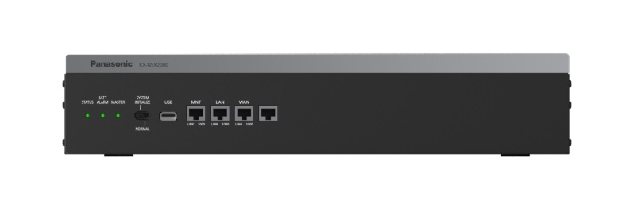
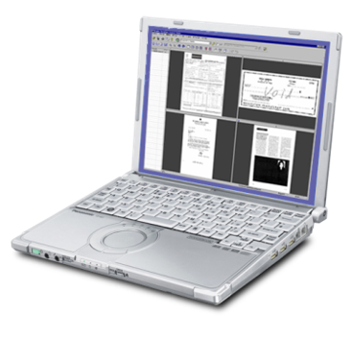
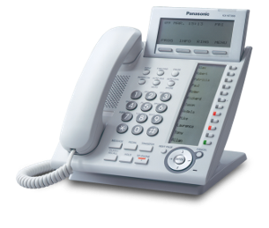

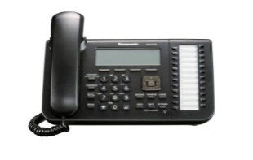
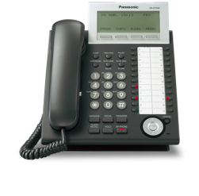
KX-NSX1000/2000Europe
Overview
Rev2.4 20 Sep., 2016
Notes:
1

Slide 2

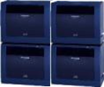








Introduction
NSX prepare for
Customer who needs
-More capacity
-Redundancy
-User concept
And aim to increase
share at
large IP PBX market
>100 Ext TDM
>100 Ext IP
NSX
TDE600
NS1000
TDE200
NS300/500/700
TE824
For Cloud
New SIP
Terminal
TEA308
HTS824
<100 Ext TDM
<100 Ext IP
Notes:
2

Slide 3
Table of Contents
This document explains System Outline and Specification
of the KX-NSX1000/2000, and is composed of the following chapters.
Chapter1 System Outline
1-1. KX-NSX1000/2000 System Overview
1-2. System Connection Diagram
1-3. Key Features
1-4 NS vs NSX
Chapter2 Configuration
2-1. Cabinet Configuration
2-2. System configuration
Chapter3 Supported Card /Terminal
3-1. Cards Specification
3-2. Terminal Compatibility
3-3. Trunk Adaptor Compatibility
Chapter4 System Capacity
4-1. System Capacity
4-2. Expansion GW Capacity
Chapter5 Hardware Installation
5-1. Items which is used for Main Unit relation
5-2. Main Unit Installation
5-3. Optional Cards Installation
5-4. Mounting Method

Slide 4
Chapter 1
System Outline

Slide 5



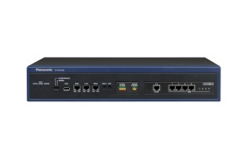

1-1. KX-NSX1000/2000 System Overview
1.Stand-alone System
- A single KX-NSX1000/2000 can be used as a stand-alone system.
- A single KX-NSX1000/2000 controls all terminals, trunks and applications.
2.Networked System
KX-NSX1000/2000 provides two methods of private networking;
- Multi-Connection Network (A network protocol only used for Panasonic products)
- QSIG Networking (via ISDN and H.323)
Master Unit
Up to 31 NS Units
IP Network
・・・
Use NS1000/700/500/300 as Expansion GW.
In addition 31 LegacyGW / Expansion Unit
can be connected.
Notes:
Master has to be NSX.
NSX can’t be slave.
NS can be slave(Expansion GW)
Legacy GW can be
TDE/TDA600/620
TDA100D
only.
NSX can support IP device only

Slide 6
1-1. KX-NSX1000/2000 System Overview
Key Concept
General Specification
High Reliability with Proprietary HW
NSX1000/2000 has Panasonic Hardware
 | NSX1000 | NSX2000
Hardware/OS | Proprietary Hardware/Linux
Max EXT/User | 1,000 Ext / 1,000 Users | 2,000 Ext / 2,000 Users
Max Trunk | 640 | 960
Max Sites | 32
Tenant | 128
Max Mail Box | 1,608*1 | 2,608*1
Max UM Ch | 128
Higher Level Redundancy
Keep P2P Call
Simplified Isolated Mode
Networking
32 Site One-Look Network
NS Series Networking
Maintenance
Need AK to maintain firmware and use
Expanded Log Feature
Panasonic SIP phone (HDV series/TGP600)
No device AK required.
*1 These number is ground total of mailbox that include mailbox for ICD-G etc.
Notes:
DECT PS count as EXT
So MAX EXT include DECT PS.

Slide 7



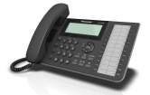


ection Diagram
1-2. System Connection Diagram
Smartphone
Remote maintenance
Server
[Remote Office]
Cellular NW
KX-HDV
series
PSTN/
ISDN
IP Network /
ITSP
PRI
E1
KX-NT500 series
Edge Router
SBC Device
E1 Trunk Adaptor/
PRI Adaptor
KX-NSX1000
KX-NSX2000
Notes:
NT5XX, NT3XX, TGP600, HDV all covered by
User AK. No device AK required.

Slide 8





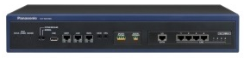


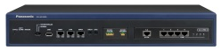

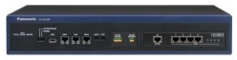

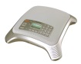



ection Diagram
1-2. System Connection Diagram
KX-NT500 series
IP Terminals
KX-NSX1000
KX-NSX2000
KX-NT300 series
KX-HDV series
KX-TGP600 series
Expansion gateways
DECT IP-CS/PS
KX-NS300/500/700
KX-NS1000
KX-NTV series
Expansion Unit
KX-NS320/520/720
Stacked PBX as Legacy Gateway
KX-TDE600/620,
KX-TDA600/620/100D
Softphone
3rd party SIP phone
KX-NT700
Application server
Web Maintenance Console
Networking
(T1/E1,E&M,ISDN-Qsig)
KX-NT3* series cannot be supported on NSX1000/2000. It is supported only on expansion gateways in multi connection system.
DPT/APT
SLT/FAX
Door phone
& Opener
MOH/BGM
Legacy CS
Legacy Terminals
Notes:
Master has to be NSX.
NSX can’t be slave.
NS can be slave(Expansion GW)
Legacy GW can be
TDE/TDA600/620
TDA100D
only.

Slide 9
1-3. Key Features
Key Selling Features
-User oriented configuration
-Smart Desk
-LDAP database synchronization
-1+1 redundancy
-Survival gateway feature
-Internal Capturing Packet Trace
-Expanded system logs
-Remote Maintenance
-Built in Centralized Unified Messaging
-Built in ACD Monitor/Report
-Built in Media Relay Gateway
-System Wireless
-Web base maintenance
-Multiple LAN network support for SIP Trunk
-SRTP supported at internal call
-Multiple administrator
-System Data file automatic back up

Slide 10
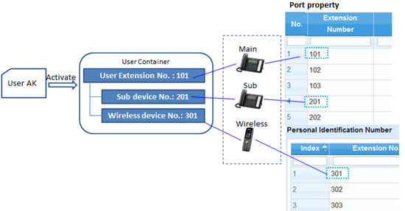
1-3. Key Features
User oriented configuration
Device type | Available Device to assign | Remarks
Main device | IP-PT, IP-softphone, SIP phone, DPT, APT*1. SLT, DECT-PS*1
Sub device | IP-PT, IP-softphone, SIP phone, DPT, SLT,
Wireless device | DECT-PS
Mobile device | Mobile phone and other public phone number
Each user can assign 3 Internal devices and 4 mobile numbers (devices) in the container.
Mobile devices Max 4
“Mobile” means outside
phone number.
User can enjoy bellow features as shared feature over multiple devices;
Parallel ringing, Transfer by off-hook
Delayed ringing, DSS key(BLF)
FWD/DND, Message Waiting, Call Log
1: If APT or DECT-PS is assigned as a main device, Sub/Wireless devices of the user cannot be assigned.
AK is required based on User Category.
Notes:
Master/Sub/PS
has to be internal device.
Setting under “4.1 Extension”
Mostly move to “User” setting
screen

Slide 11
1-3. Key Features
User oriented configuration -Condition-
User grade | Main device | Wireless device | UM Mailbox | UM E-mail 2way-Rec | Mobile number | Sub device | Auto 2way manager
Normal user | Yes | Yes | Yes | Yes | No | No | No
Mobile user | Yes | Yes | Yes | Yes | Yes | No | No
Advanced user | Yes | Yes | Yes | Yes | Yes | Yes | Yes
Each user has to specify a grade from user grades of three stages. Available devices and services in accordance with the grade are different. Following table shows availability for each user grade.
User grade | Require activation key(AK) | Remarks
Normal user | Normal user AK | Normal user AK: KX-NSUN* Mobile user AK: KX-NSUM* Advanced user AK: KX-NSUA*
Mobile user | Normal user AK + Mobile user AK
Advanced user | Normal user AK + Mobile user AK + Advanced user AK
Add Advanced
to Normal and skip
Mobile then work as
Normal
Upgrade
Upgrade
SIP extension activation key (KX-NSXS*) and Panasonic Peripheral Device activation key (KX-NSXN*) are not user based activation key. They are device based activation key.
AK is required based on User Category.

Slide 12
1-3. Key Features
User oriented configuration -Condition-
 | NSX1000 | NSX2000
Max. User number | 1000 | 2000
Main device | 1000 | 2000
Sub device
Wireless device
Mobile number(device)
Maximum user number is varied based on how many device assigned.
For example;
If all of the users assign main+sub+wireless+4 mobile number then maximum user number will be ;
NSX1000: 142users (1000/7), NSX2000: 285 users (2000/7)
CTI
Main, Sub, Wireless device can be treated as same EXT at CTI message level.
User can be created by following steps.
1) Create User container
2) Set user extension number
3) Set User level (Normal/Mobile/Advance)
4) Activate user activation key for the user
5) Set a device setting and device number
6) Registration of the device
Notes:
DECT PS count as EXT
So MAX EXT include DECT PS.

Slide 13
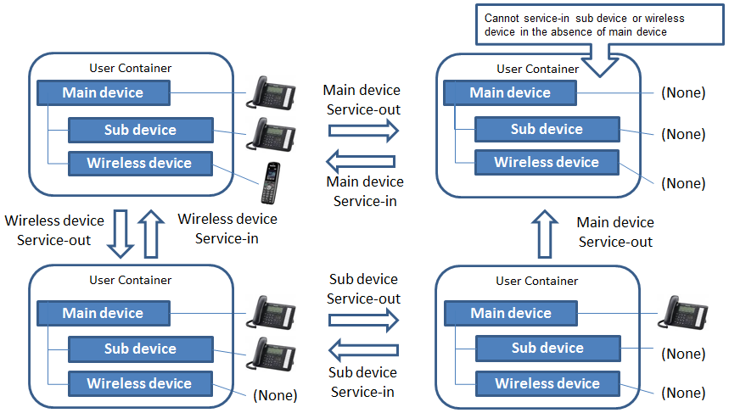
1-3. Key Features
Smart Desk
A device that a user uses as his extension terminal can be in unavailable status (service -out status) which does not belong to any user by service-out operation.
From the device in service-out status, it is available as an extension terminal of the use by service-in operation.
Useful feature at free layout office or call center agent.
Notes:
Due to this implementation
No “Walking EXT” feature on NSX
Feature Code for Smart Desk is differ from
“Walking EXT”.
In case “Service Out “ status
only Emergency call available

Slide 14






1-3. Key Features
Smart Desk
Free layout Office
Port J
<Main Device>
Service IN->Out
User 300
Company
Outside
Company
Remote office
Port K
<Main Device>
Service Out->In
User 300
Normal user
Port L
<Main Device>
Service IN->Out
User 300
Port P
<Main Device>
IP-Softphone
Service Out->IN
User 300
Port L
<Main Device>
Service IN
User 300
Port N
<Sub Device>
Service Out->In
User 300
Advanced user
Notes:
FWD can be set at any device belong
to user.
Due to user concept there is no Parallel
ringing with mobile feature on NSX.
IRNA can be deployed as call
backup after FWD.
FWD, IRNA enable/disable can be set during
All Service Out.

Slide 15
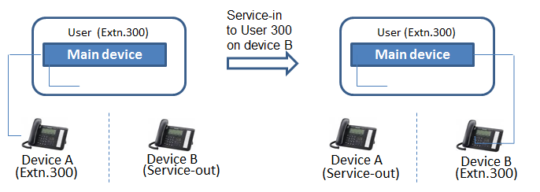
1-3. Key Features
Smart Desk -Condition-
<Supported devices>
Following devices are available for this feature.
IP-PT, DPT, SLT, DECT-PS, Panasonic IP-softphone
Note: 3rd party SIP phone and KX-HDV series, KX-UT series, KX-TGP600,
DSS console (KX-DT590/390), are not supported.
While service-out, most of service are limited and only service-in operation and emergency call are available.
User, who has already service-in device, can service-in from other device which is in service-out. The original service-in device is into service-out automatically.
The login / logout of ICD group can be performed in conjunction with service- in / service- out. This is system option.

Slide 16
1-3. Key Features
LDAP database synchronization
Following 3 data can be used by this synchronization.
1)User data : For maintain PBX user’s information.
2)LDAP directory service : Use data on LDAP as system phonebook.
3)Name display by LDAP at incoming call : Use data on LDAP as system phonebook.
“2) and 3) use same DB only”
<User data>
Manual synchronization
User data in LDAP database can be reflected manually on the specified user parameter of NSX1000/2000.
Scheduled synchronization
Scheduled synchronization is provided. It is available to the user that manual synchronization is completed for.
Useful feature to maintain employee information and customer phone numbers by single database .
AK is required. Only 1 LDAP server connection to entire system.

Slide 17
1-3. Key Features
LDAP database synchronization
<LDAP directory service>
with DPT, IPPT and IP-Softphone
User can make outgoing call based on phone number in the LDAP database.
This operation can be done at “External Directory” feature on PT.
･･･ ⇔ Personal Directory ⇔ System Directory ⇔ External Directory ⇔ Extension Directory ⇔
Feature Access ⇔ Incoming Call log⇔ Outgoing Call log ⇔ ･･･
LDAP data is searched by name entered as search key, and then maximum 3 numbers can be present as single search result. (Ex. Office, Home, Mobile)
Feature code of local trunk access can be added automatically when getting the data from LDAP database. (System programming)
LDAP directory to search can be assigned for each tenant. (System programming)
Notes:
“Local Access” feature code
only can be deployed

Slide 18
1-3. Key Features
LDAP database synchronization
< Name display by LDAP at incoming call>
with PS, DPT, IPPT and IP-Softphone
As with personal directory and system directory, the name by searching name from caller ID can be displayed on the phone when incoming a call.
The name by LDAP database is displayed in case of no matched data by personal directory and system directory,
LDAP directory to search can be assigned for each tenant. (System programming)

Slide 19
1-3. Key Features
LDAP database synchronization -Condition-
Activation Key for LDAP (KX-NSXF005) is required for these features.
NSX1000/2000 supports one LDAP database server to connect.
Following table shows supported LDAP database.
LDAP database | Remark
Active Directory 2008 R2, Active Directory 2012
OpenLDAP Version 2.4.xx
<User data>
Manual synchronization
The direction of the synchronization is one way (only LDAP DB to PBX) is supported.
LDAP data is searched by name entered as search key and the reference data, which is phone number and e-mail address and so on, of the matched user is taken out from the database. Then the data is set into the user parameter. This is manual operation at each user menu in web programming.
The attribute of LDAP database to be reflected are specified to each user parameter beforehand.
Scheduled synchronization
Schedule can be created by selecting from “Daily”, “Weekly”, “Monthly”.Also provides the ability to synchronize immediately.This scheduled synchronization can be disable per user.

Slide 20
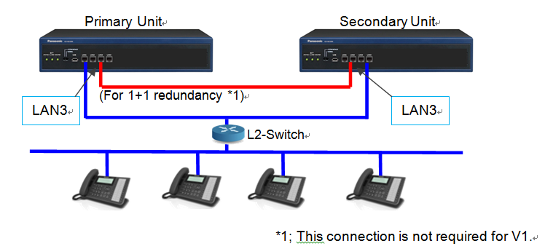
1-3. Key Features
V2
1+1 redundancy
LAN3
Following activation keys are required for the secondary unit apart from
the primary’s ones.
1)System Activation Key
(KX-NSX101/ KX-NSX201)[Mandatory]
2)Maintenance annual Key
(KX-NSX2201) [Mandatory]
3)Remote Maintenance annual
Key(KX-NSX6211) [Option]
LAN1/2
LAN1/2
Switch
Automatically switch to Secondary while detecting primary failure. This can be deployed by additional
LAN connection through “LAN3”.
System data is transferred periodically and while data has changed from Primary to Secondary.
The maximum length for a cable for LAN3 is 100 m ( Cat5e or higher )
Redundancy AK is required on Primary only.
Notes:
LAN1/2 for regular LAN connection
LAN3 for Data transfer

Slide 21
1-3. Key Features
V2
1+1 redundancy
Item | Basic feature support
Switching Condition | Auto + Manual
Switch back Condition | Manual
Data Transfer | Refer following Slide about detail
Target data to transfer | Most of system data except data stick with unit(ie IP address etc)
P2P call kept | NT5-NT5
Call via DSP kept | -
Secondary server AK | 1)System AK, 2)Maintenance AK/[Mandatory] 3)Remote Maintenance AK [Op]
APL server | Automatic switch (Status initialize)
Notes:
ExpGW Reboot and call
Disconnect.
Cable for LAN3 connection
is OK with regular RJ45 cable.
LAN1/2 for regular LAN connection
LAN3 for Data transfer
P2P call kept is not available HDV/TGP
FWD On/Off setting can be BackUp

Slide 22
1-3. Key Features
V2
1+1 redundancy -Data transfer flow-
While Secondary Active
Data Transfer Flow
While Primary Active
LAN 3 IP address/Fixed
Primary :222.0.0.1
Secondary :222.0.0.2
-Normal operation condition, means Primary as Active unit and Secondary as Stand-by unit then Data transfer deployed from Primary to Secondary. The data can be transferred even Secondary become Active Unit.
-Primary unit connection to Secondary has to resume within 30days after Primary failure, otherwise Secondary unit
will be stopped.
-While Secondary Unit become Active unit then it can continue to work even after Primary unit re-connecting
to the network.

Slide 23
1-3. Key Features
V2
1+1 redundancy -Transferring Data-
Data type | Transfer timing
System configuration data | Periodic System data save Data change and save or log out from Web MC
UM prompt | Store/delete data
UM stored message | Store/delete message
OGM、MOH/BGM recorded data | Store/delete data
SMDR | While EXT terminate call
Call log | System data save
Data for hotel feature | Store/delete data
ACD report data | Create Report
Data Transfer start after completing process mention above.

Slide 24

1-3. Key Features
Survival gateway feature (Simplified Isolated mode)
Expansion gateway will be in “Simplified Isolated Mode” in case of,
NSX Master can’t be detected during starting up or running as Expansion GW
Manually switch to “Simplified Isolated Mode”
There is basic operation only such as outgoing and incoming call during this mode.
“Simplified Isolated Mode” can be continued for 30 days.
The mode is expired after 30 days. When 30 days passed all services are stopped until switching back to normal mode.
“Simplified Isolated Mode” can be released either manual operation, scheduled or automatic.
ExpGW1
“Simplified Isolated Mode”
Required AK:
KX-NSXF006 Expansion GW (Master)
Required AK:
KX-NSXF007 Expansion GW(Slave)

Slide 25
1-3. Key Features
Survival gateway feature (Simplified Isolated mode) -Condition-
<Activation keys>
No additional Activation key is required to use “Simplified Isolated Mode” on top of
KX-NSXF007 Expansion GW(Slave).
<Programming>
To setup NS series PBX as Simplified Isolated Mode, it is required to program individually
them beforehand.
Otherwise “Simplified Isolated Mode” will not be functioned.
For example, IPPhone need to register at both Normal mode(connect to NSX) and Simplified
Isolated Mode.
There are 2 ways to program.as follows.
1. Online Programming
Put an expansion GW to Simplified Isolated Mode manually, then program it using WEB Maintenance
console of NS. After completing the programming, put it back to normal mode.
2. Offline Programming
Create DxSYS file of NS by using offline tool of NS system, them upload the DxSYS file into
Expansion GW.

Slide 26
1-3. Key Features
Survival gateway feature (Simplified Isolated mode) -Condition-
<Limitation of Simplified Isolated Mode operation>
During “Simplified Isolated Mode “ works according to the configuration setting for the mode. The level of supported features is NS series ver.4.2, The new feature from NSX series, such as Smart Desk, LDAP directory service and so on, are not supported.
And some of features are restricted in the mode and the restricted features are as follows.
Un available feature | Description/Conditions | Notes
Built-in UM (including Auto 2-way recording, 2-way recording, FAX) | UM on an expansion GW is not available.
CTI Interface(3rd party CSTA) | 3rd Party CTI Interface is not available
Built-in ACD monitor/report | No ACD monitor / report is available
- Number of available resources (such as extensions, trunks, DSP etc.) depends on each NS model.
- System logging data (such as SMDR, Call Log etc.) is not merged into NSX call server when
the system back to normal mode as well as NS system.
- NSX system shows the status of running mode by flexible button on specified PT.
- When one-look mode changes to Simplified Isolated mode, system reboot occurs.
Notes:
OGM necessary to install
cabinet by cabinet same like
NS One-Look

Slide 27
1-3. Key Features
Survival gateway feature (Simplified Isolated mode) -Condition-
Model | Feature Description | Remarks
KX-NSM099 | IP Capacity EXP(640EXT) | NS1000 only
KX-NSM102/108/116 | IP Trunk AK
KX-NSM201/205/210/220 | IP Softphone, IP Terminal
KX-NSM501/505/510/520 | IP terminal
KX-NSM701/705/710/720 | 3rd Party SIP terminal
KX-NSE201/205/210/220 | IP-CS channel expansion
KX-NSF990 | For VoIP | NS300 only / only for IP, not for UM
KX-NSF991 | Expansion AK | NS700 only
KX-NSN101 | Built In Router | NS1000 only
Above Activation key will be automatically deployed to Gateway. Feature related AK other that above AK will not work even AK installed to system before.
Trunk and EXT can be used up to maximum capacity while working as “Simplified Isolated Mode”.

Slide 28
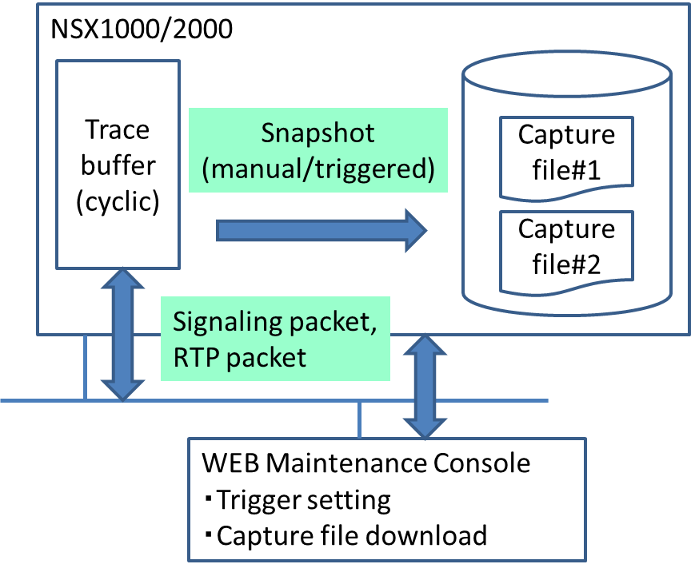
1-3. Key Features
Internal Capturing Packet Trace
Built-in packet trace utility support to obtain packet trace data with no any extra devices such as PC.
The system has 300Mbytes trace buffer inside which allows logging trace IP packet for about 5 minutes in case the traffic of data transmission speed is 8Mbps.
Packet trace data is stored into this buffer periodically and there is an option to specify trace type of “signaling” or “signaling + media stream”.
Also the system can make up to 2 snapshots in the storage. It is available to take it manually or automatically when the system detected pre-assigned error code of Major/Minor errors
Capture files are available to download via web-maintenance console (new screen). The file format is “pcap” so that they can be browse existing tools such as Wireshark.
Useful feature to get Wireshark capture for trouble shooting.
AK is required.

Slide 29
1-3. Key Features
Expanding system logs
Type | Capacity | Log item | Reference
Error Log - Information | 2,000 | - Time adjustment - (Security log)
WEB Operation Log | 40,000 | - Login/Logout operation (successes) with each level of INSTALLER/Administrator/User - Login/Logout operation (fail) with each level of INSTALLER/Administrator/User level - Changing history of system database*)
Service Operation Log | 4,000 | - Service-in/Service-out operation | Smart Desk
 |  | - Remote operation log | User remote operation (walking COS, verification code)
IP extension statistical information | 30 days | - Records VoIP quality (statistical information of RTP packet) for specified IP-PT. - Total number of received, lost and abandoned packets is recorded at hourly intervals. - Maximum and minimum transmit time is recorded as well.
Security Log | (2,000) | - Record an error log (information) when “Ping attack” detected. - Record an error log (information) when “SIP attack” detected.
Useful feature for trouble shooting. AK is required.

Slide 30


1-3. Key Features
Remote Maintenance
Panasonic-Cloud
Remote Module
Administrator
NSX system
KMS
Remote Module
NSX system supports easy and secure remote access with no port forwarding on an edge router/firewall. This mechanism is realized by collaborating with KMS server and remote maintenance server built on Panasonic cloud environment.
System administrator can access easily all end-user’s NSXs through KMS server at any time and from anywhere.
Useful feature to get easy remote access. AK is required.

Slide 31

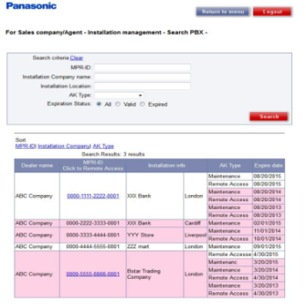
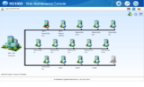

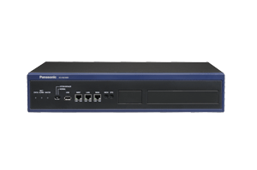







1-3. Key Features
Remote Maintenance
Dealer A List
AK
Company A
OK
KMS Site
Company B
OK
Company A
Company C
OK
Company A List
1.AK File Download
KX-NSX6211
MPR1
Connect
MPR-ID：MPR1
MPR2
Connect
Dealer
Device management master
5.Select PBX
MPR3
Connect
3.Install AK File
Administrator
4. Install Client Certificate
6. Issue the token
2.MPR-ID is registered on PCPF
Client Certificate
Selection
WebMC
Telnet
Web Socket
FTP
WebMC Access
Remote Access
Control I/F
Web socket
Control I/F
7. Select Service
8. Start Remote access
FTP/TELNET
Access
AK File/Client Certification
is requested to install
’WebMC’
Panasonic Cloud PlatForm

Slide 32
1-3. Key Features
Remote Maintenance -Condition-
This service requires an activation key (KX-NSX6211). This activation key is valid for 1 year, so it needs to be installed every year.
To access NSX remotely, an administrator needs to login to KMS server first using browser (HTTPs). The administrator will reach “remote administration portal”, then can select a remote site to be maintain in the pre-registered system list. The administrator reaches “login” popup of NSX then login to the NSX as same operation as on-site maintenance.

Slide 33



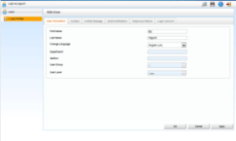
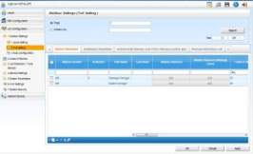
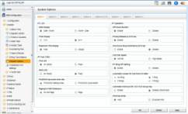
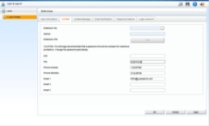
1-3. Key Features
Web base maintenance
Installer Office
Web Maintenance
-Programming is easy for experienced Panasonic
installers because the programming method is basically
the same as the KX-TDE, KX-NCP and KX-TVM.
-No need to install dedicated software on your PC.
-Use an IP network to perform programming from
remote sites.
-A maximum of 1 installer can modify system data at the
same time.
-A maximum number of user in the system can access
at the same time.
Public/
Private
IP Network
User
Web Console
Fwd/DND, VM greetings, and e-mail addresses etc…
can be set from a PC
NSX Version | I. E. Version | Firefox Version | Chrome Version | Remarks
1.0 | 9, 10, 11 | 40, ESR38 | 43, 44※2 | Chrome only for User

Slide 34
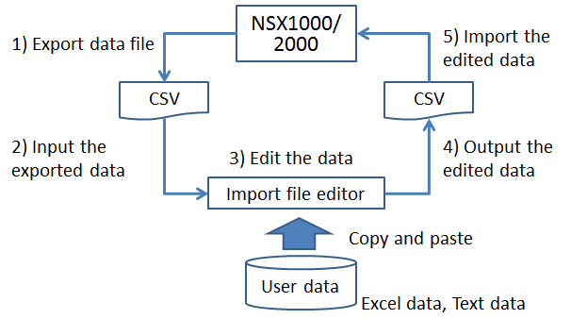
1-3. Key Features
Web base maintenance
System programming/User programming
Type |  | Programming level | User Interface | # of simultaneous access
On-line | System Programming | Installer | Web base | 1
 |  | Administrator | Web base | 1
 | User Programming | Personal WEB Portal | Web base | 1000 / 2000
 |  | PT/PS programming | Handset operation | 128
Off-line | System Programming | Installer | Windows Tool | -
NSX supports 4 types of online programming and off-line programming. Programming concept and basic programming method is same as NS’s one. New programming interface “Personal WEB Portal” is designed to support “User Concept” feature.
Dedicate tool will be provided as off-line tool to conduct edit and import data to the system.
1)User information: Extension number, name and other data in user container
2)System speed dial data
3)Verified code
4)DDI/DID table
Notes:
No Off LineTool for NSX
←Trouble shooting need NSX
hardware

Slide 35
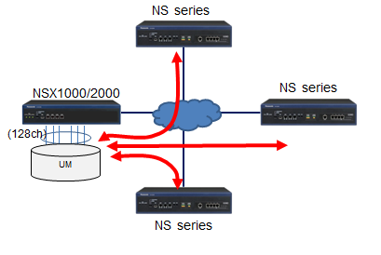

1-3. Key Features
Built in Centralized Unified Messaging
NSX has all resource related to UM and distribute UM service for entire system include ExpGW.
Fax to UM is available by installing a fax cards on NS1000 as expansion gateway.
UM Ch / Mail Box | 128ch / 2,608
Symbol | Model | Name | Function Summary
SSD-S | KX-NSX2135 | Solid State Drive module S-size | VM recording time:200H
SSD-M | KX-NSX2136 | Solid State Drive module M-size | VM recording time:400H
SSD-L | KX-NSX2137 | Solid State Drive module L-size | VM recording time:800H
SSD-LL | KX-NSX2138 | Solid State Drive module LL-size | VM recording time:1600H
Easy to maintain and control.
AK and optional SSD is required.

Slide 36


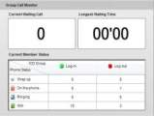
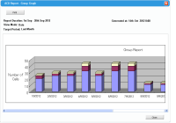
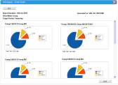

1-3. Key Features
Built in ACD Monitor/Report
Queue Announcement
Built In call center feature support by NSX such as;
- Queue announcement
- Automatic Conversation Record
- Report for Management
- Live Status Monitor for Supervisor
Good for all company who deal with their customer by phone.
“You are 1st in the queue.”
:
KX-NSX
Live Status Monitor
Record conversation
Customer
Agent
Save the voice data
Activity Report
NAS Server
AK is required.
Supervisor

Slide 37








1-3. Key Features
Built in Media Relay Gateway
Head Office
Home Office
MRG
Built-in
Branch Office
IP Network
IP phones can be installed at a remote office without a PBX via an IP network. A VPN is not required.
Good for remote workers!
Outside
No AK is required.

Slide 38




1-3. Key Features
System Wireless
Tough type Model
KX-TCA385
KX-NS0154 (LAN Sync)
User can receive customer calls any location in the company. Automatic hand-over allows smooth conversations on the move.
Also user can choose Portable Station according their specific needs, such as Tough type.
Easy and Cost effective
Wireless system.
IP6X
With LAN synchronization
Dust
resistance
Cell stations can be installed easily.
Easy to expand ch of each Cell.
IPX5
Splash
proof

Slide 39


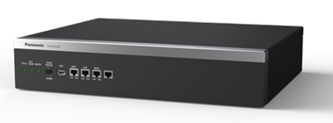
1-3. Key Features
V2
Multiple LAN network support for SIP Trunk
One NSX1000/2000 support multiple SIP provider and multiple LAN segment
External
NW
SIP carrier 1
SIP carrier 2
Internal LAN
NAT
NAT
NSX1000/NSX2000
L3-switch
Default GW of NSX1000/2000 is L3-switch
There is only 1 NAT Traversal rule can be set in the past.
8 different NAT Traversal rule settings can be set.
So up to 8 multiple SIP carrier can be supported even all of them need individual NAT Traversal rule.

Slide 40
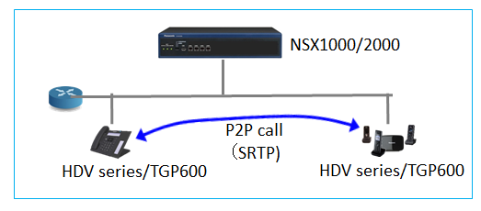
2. How it work?
V2
SRTP supported at internal call and SIP-TLS
SRTP (Secure Real time Transport Protocol) is supported at internal calls on NSX1000/2000. Following table shows supported type of call and devices for SRTP communication.
Type of call | Only P2P call
Supported device | KX-HDV series (*1) and KX-TGP600
*1: HDV100/130 don’t support this feature.
HDV and TGP600 need to up grade firmware to support this feature.
Supported firmware may release at same time as NSX V2.
HDV V2.2XX(version name may vary) will support these features.

Slide 41
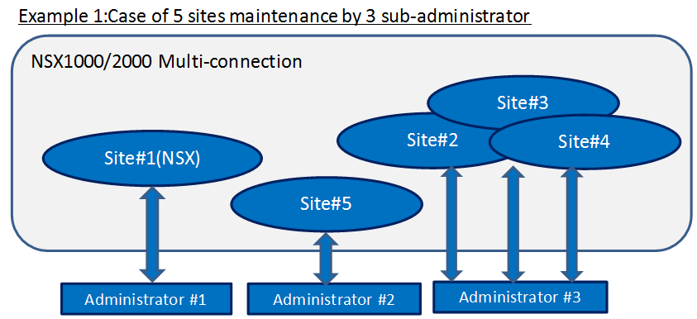
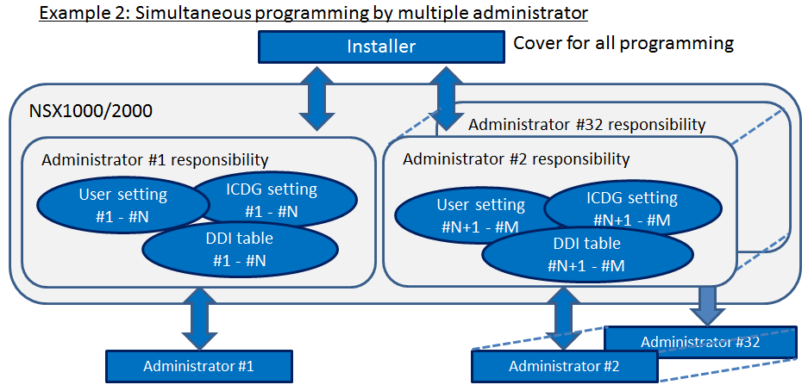
1-3. Key Features
V2
Multiple administrator
The sub- administrator account (Max 32 accounts) will be added.
Following 2 type of management can be provided by this account..
Site administration
Site related data, device and trunk port data,
IP device registration, isolated mode recovery,
and so on can be maintained.
Simultaneous installation
User setting, DDI table, ICG group setting can be divided and assigned to the responsible sub-administrators

Slide 42
1-3. Key Features
V2
System Data file automatic back up
1) Back up to internalmemory
System data file, DxSYS, can be backed up into internal memory of NSX1000/2000 automatically every day.
Maximum 30 files can be stored, and an oldest file is deleted when itmore.
2) Restore and file transfer
Afile which is selected from backed up files can be restored into NSX. And also a selected file from backed up
files can be transferred to USBmemory or NAS.
3) Back up to external storage
NSX1000/2000 supports to back up the system data file. The data file can be transferred to USB memory or
NAS automatically every day. There is no limit to transfer the number of files, and it depends on capacity of the
storage to transfer.

Slide 43
1-4. NS vs NSX
■ NS1000 don’t need maintenance AK. But NSX series need maintenance AK (mandatory).
■ 2 model line up: NSX1000 and NSX2000. (sales channel is different)
 | NS1000 | NSX1000 | NSX2000
Max Extension(1sys) | 640 | 1,000 | 2,000
Max Extension（Network） | 1,000 | 1,000 | 2,000
Simultaneous Call number | 255 | Up to capacity
User Concept | No | Yes
Network site | 16 | 32
tenant | 32 or 128 | 128
Maintenance AK | No | Yes (mandatory)
Online certification | No | No
Remote maintenance | No | Yes （need AK）
AK kind | AK for NS series | New AK for NSX series
Time limited AK | No | Maintenance AK / remote maintenance AK
Maintenance console | Web-MC | Web-MC + Off-line Data Editor
Capacity AK | 50/100/300/640 extn. | Not required
Slave function(one look) | Yes | No
WAN Port | Yes | No (use expansion GW)
Built-in router | Yes | No
Redundancy | Network Survivability | 1+1 redundancy
Stacking card | Yes | No (use expansion GW)
Built-in FAX server | Yes（card 1ch) | No (use expansion GW)
Notes:
DECT PS count as EXT
So MAX EXT include DECT PS.

Slide 44
Chapter 2
Configuration

Slide 45

2-1. Cabinet Configuration
Front Cabinet
Name | Display | Feature |  |  | Remarks
LED Indications | STATUS | PBX status indication |  |  | Three Colors (Green, Amber, Red)
 |  | Off | OFF: Power Off
 |  | Green | ON: Power On and running Flashing: Starting up/Logging in
 |  | Amber | ON: Ready to shutdown, Flashing: Shutting down
 |  | Red | ON: Alarm (CPU stop, no IP addresses assigned for the DSP cards by the DHCP server, alarm for each optional service card) Flashing: Initialize failed
 | BATT ALARM | Lithium Battery Voltage Low Alarm indication
 |  | Off |  | OFF: Normal,
 |  | Red |  | ON: Alarm
 | SYSTEM MODE | SYSTEM Mode indication |  |  | Three Colors (Green, Amber, Red)
 |  | Green |  | ON: Primary
 |  | Amber |  | ON: Secondary
System Mode Switch | SYSTEM INITIALIZE | “Initialize mode“ or “Normal mode” switching |  |  | Slide switch
 | NORMAL

Slide 46
2-1. Cabinet Configuration
Front Cabinet
Name | Display | Feature | Remarks
LAN Interface | MNT | Gigabit LAN Interface for Maintenance 10/100/1000BASE-TX | RJ45
 | LAN1 | Gigabit LAN Interface for IP Trunk/IP Extension/Expansion GW 10/100/1000BASE-TX | RJ45
 | LAN2 | Gigabit LAN Interface or IP Trunk/IP Extension/Expansion GW 10/100/1000BASE-TX | RJ45
 | LAN3 | Gigabit LAN Interface for IP Trunk/Extension or Redundancy 10/100/1000BASE-TX | RJ45
USB Interface | USB | USB2.0 port for DATA Backup. *Specified USB flash memory only | TYPE A

Slide 47
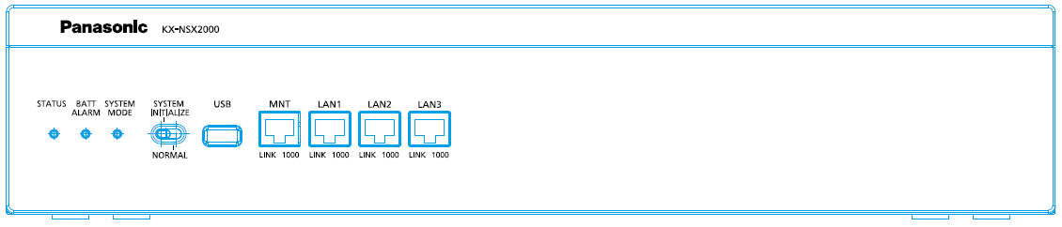
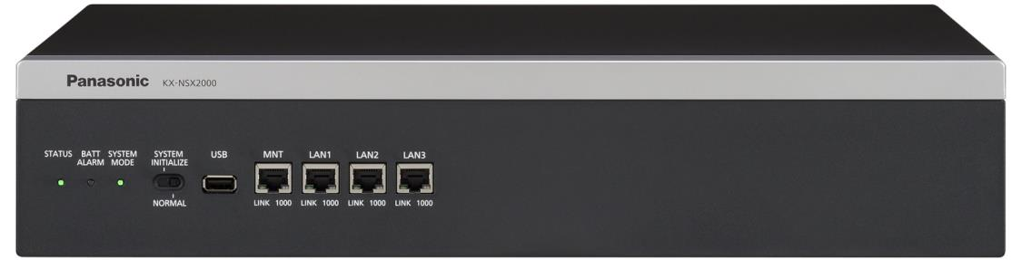
2-1. Cabinet Configuration
Front Cabinet layout

Slide 48
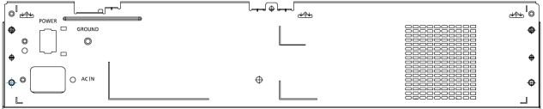
2-1. Cabinet Configuration
Rear Cabinet
Name | Display | Feature | Remarks
AC Power Switch | POWER | AC power switch
AC Inlet | AC IN | AC Inlet
FG Terminal | GROUND | Frame Ground
FAN | - | Air-cooling
AC cable is optional. Not come with main cabinet.
Symbol | Model | Name | Function Summary | Remarks
AC cable | KX-A412 | AC cable | Optional AC cable

Slide 49

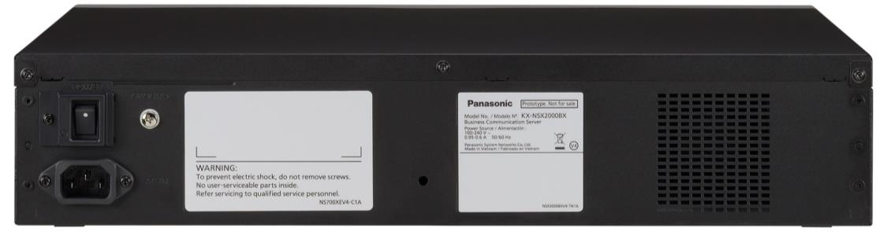
2-1. Cabinet Configuration
Rear Cabinet panel layout

Slide 50
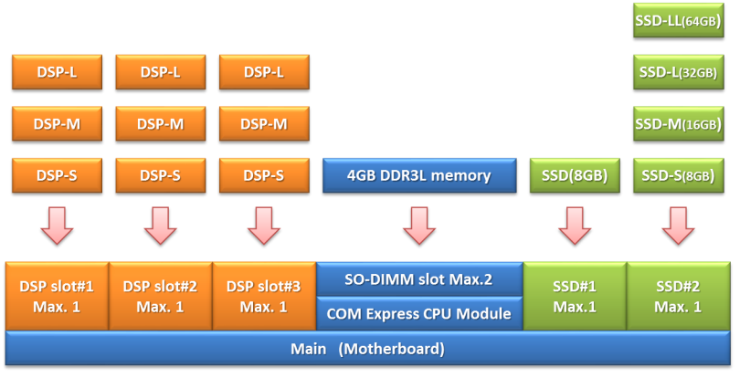
2-2. System Configuration(1)
Main Component
Card/Unit | Max. Number | Installed In | Remarks
COM Express CPU Module | 1 | Main (Mother board) | Initial mounted
4GBDDR3L Memory | 1 | COM Express CPU Module | Initial mounted
SSD(8GB) | 1 | SSD#1 slot on Main (Mother board) | Initial mounted
SSD-LL(64GB) | 1 | SSD#2 slot on Main (Mother board) | Option
SSD-L(32GB) | 1
SSD-M(16GB) | 1
SSD-S(8GB) | 1
DSP-L | 3 | DSP#1 and DSP#2, DSP#3 specified slot. | Same as NS1000
DSP-M | 3 |  | Same as NS1000
DSP-S | 3 |  | Same as NS1000

Slide 51
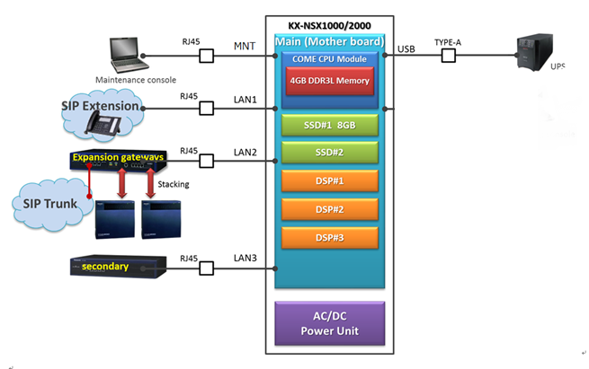
2-2. System Configuration(1)

Slide 52
2-2. System Configuration(2)
DSP (Digital Signal Processor) Cards
To digitally process audio signals, such as a telephone call, the PBX must use a certain number of DSP resources. DSP resources are provided by the DSP cards installed in the PBX. Since there are a limited number of DSP resources, no further operations (e.g., telephone calls, playing an OGM) can be performed if all resources are being used.
There are 3 types of DSP cards.
- DSP-S / DSP-M / DSP-L
Item | Model | Name | Function Summary | Remarks
DSP-S | KX-NS0110 | VOIP DSP-S card | VOIP, DISA, Conference & Unified Messaging | Current product for NS1000
DSP-M | KX-NS0111 | VOIP DSP-M card | VOIP, DISA, Conference & Unified Messaging | Current product for NS1000
DSP-L | KX-NS0112 | VOIP DSP-L card | VOIP DISA, Conference & Unified Messaging | Current product for NS1000
The DSP capacity (processing performance) can
be expanded.
Up to 3 DSP cards can be installed to the PBX.
-> The combination of mounting is free.
The following list shows some of the basic operations that require DSP resources.
- VoIP calls
- Conferences
- Unified Messaging feature
- DISA /OGM feature
If OGM 128ch simultaneous access occurs, at least 1 DSP-L is required.

Slide 53
2-2. System Configuration(3)
SSD (Solid State Drive) Cards
Optional SSD Card is required for using Unified messaging features.
There are 4 types of SSD cards.
->SSD-S (:200h) / SSD-M (:400h) / SSD-L (:800h) / SSD-LL (:1600h)
The Unified Messaging feature can be used with above SSD only.
Solid State Drive card
Symbol | Model | Name | Function Summary | Remarks
SSD-S | KX-NSX2135 | Solid State Drive module S-size | VM recording time:200H
SSD-M | KX-NSX2136 | Solid State Drive module M-size | VM recording time:400H
SSD-L | KX-NSX2137 | Solid State Drive module L-size | VM recording time:800H
SSD-LL | KX-NSX2138 | Solid State Drive module LL-size | VM recording time:1600H
SSD
Mount to Main unit
NSX
When optional SSD card is installed in unit, up to 128ch are available for UM.

Slide 54
2-2. System Configuration(4)
USB Interface
USB interface provides communication between the PBX and user-supplied devices
such as a USB memory device.
->The PBX is equipped with a USB 2.0 interface.
Using a USB memory device
A USB memory device can be used to backup and restore the system data of the PBX.

Slide 55
2-2. System Configuration(5)
Physical Interface Cards
There is no Physical Interface Card.

Slide 56
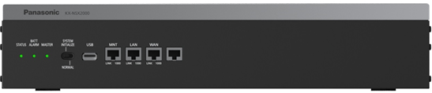

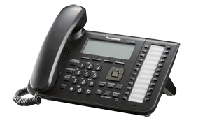

2-2. System Configuration(6)
Virtual cards are included with the Mother board of the NSX
Virtual cards can be activated with the appropriate activation key.
By installing Virtual Cards in the Virtual Slots of the Mother board using Web Maintenance Console, IP trunks, IP extensions and IP-CSs can be used via the Mother board.
Main Processing Software
on the Mother board
Inside
V-SIPGW128
V-SIPEXT128
V-IPCS16
Virtual Slot
Virtual Cards
V-IPGW128
V-IPEXT128
Ethernet
Other PBX
IP Telephony
Service
IP-PT
SIP-Phone
IP-CS
Notes:
56

Slide 57
2-2. System Configuration(7)
Activation Key for each Feature
If you want to use the following features, Activation Key is required.
For NSX
For NSX
-System Activation Key
-Maintenance annual Key
-Remote Maintenance annual Key
-User Concept Activation Key
Normal/Mobile/Advanced
-IP Trunk channel(H.323/SIP)
-General SIP Phones
-Panasonic Doorphone/ IP-Cam
-IP-CS Channel Expansion
-Unified Messaging related Features
Two-way Rec control Feature
Message Backup Features
-Call Center Features
Report/ Queue Announce combined
-Call Center Report only
-Call Center Queue Announce only
-Multiple CTI Connection
-LDAP Connection
-Expansion GW Connection
-Redundancy
For NS
The AK for EXP. GW is installed in NS via NSX.
-Expansion GW Connection
-Built In Router

Slide 58
2-2. System Configuration(8)
System Activation Key
 | Description | Model Name | Feature
Main | NSX2000 System Activation Key | KX-NSX201 | Activate NSX2000 main features Only for NSX2000
 | NSX1000 System Activation Key | KX-NSX101 | Activate NSX1000 main features Only for NSX1000
Maintenance | Maintenance annual Key | KX-NSX2201 | Maintenance annual license (tech support / software upgrade) No necessary for 1st year, required from 2nd year
 | Remote Maintenance annual Key | KX-NSX6211 | Remote maintenance annual license
Maintenance annual Key is mandatory from 2nd year for software upgrade and tech support.
If user purchases Maintenance AK 3 years later, User needs to buy each AK for 3 years except 1st year.

Slide 59
2-2. System Configuration(8)-1
Annual Activation Key
System Activation Key include maintenance AK for 1st year.
The start date is fixed by installing System Activation Key to validate system.
KX-NSX*01 install
Expire Date= DD/MM/YY+365+31
You could get e-mail from NSX
10 days before AK expire.(need set up)
based on the date you install AK file to NSX.
Validate Date =DD/MM/YY
Add “KX-NSX2201”
365 days can be extend
To get AK file (NS2201) can be specific period of time. 30 days before expiring previous AK file.
KMS server send e-mail notification 30 days before expiry date based on original download date.

Slide 60
2-2. System Configuration(9)
User Concept Activation Key
 | Description | Model Name | Feature
User Concept | 1-Nomal User Concept Activation Key | KX-NSUN001 | Activate 1 Normal user
 | 10-Normal User Concept Activation Key | KX-NSUN010 | Activate 10 Normal user
 | 50-Normal User Concept Activation Key | KX-NSUN050 | Activate 50 Normal user
 | 100-Normal User Concept Activation Key | KX-NSUN100 | Activate 100 Normal user
 | 500-Normal User Concept Activation Key | KX-NSUN500 | Activate 500 Normal user
 | 1-Moblie User Concept Activation Key | KX-NSUM001 | Activate 1Mobile user from Normal user
 | 10-Moblie User Concept Activation Key | KX-NSUM010 | Activate 10 Mobile user from Normal user
 | 50-Moblie User Concept Activation Key | KX-NSUM050 | Activate 50 Mobile user from Normal user
 | 100-Moblie User Concept Activation Key | KX-NSUM100 | Activate 100 Mobile user from Normal user
 | 500-Moblie User Concept Activation Key | KX-NSUM500 | Activate 500 Mobile user from Normal user
 | 1-Advanced User Concept Activation Key | KX-NSUA001 | Activate 1Advanced user from Mobile user
 | 10-Advanced User Concept Activation Key | KX-NSUA010 | Activate 10 Advanced user from Mobile user
 | 50-Advanced User Concept Activation Key | KX-NSUA050 | Activate 50 Advanced user from Mobile user
 | 100-Advanced User Concept Activation Key | KX-NSUA100 | Activate 100 Advanced user from Mobile user
 | 500-Advanced User Concept Activation Key | KX-NSUA500 | Activate 500 Advanced user from Mobile user

Slide 61
2-2. System Configuration(10)
General SIP Phones
 | Description | Model Name | Feature
3rd party SIP -Extension | 1-Channel SIP Extension Activation Key | KX-NSXS001 | Activate 1 SIP-Phone for 3rd party
 | 10-Channel SIP Extension Activation Key | KX-NSXS010 | Activate 10 SIP-Phone for 3rd party
 | 50-Channel SIP Extension Activation Key | KX-NSXS050 | Activate 50 SIP-Phone for 3rd party
 | 100-Channel SIP Extension Activation Key | KX-NSXS100 | Activate 100 SIP-Phone for 3rd party
 | 500-Channel SIP Extension Activation Key | KX-NSXS500 | Activate 500 SIP-Phone for 3rd party
Panasonic Doorphone/ IP-Cam
 | Description | Model Name | Feature
Panasonic Peripheral Device | 1-Channel Peripheral Device Activation Key | KX-NSXN001 | Activate 1 Communication Camera/IP-Doorphone
 | 10-Channel Peripheral Device Activation Key | KX-NSXN010 | Activate 10 Communication Camera/IP-Doorphone

Slide 62
2-2. System Configuration(11)
IP-CS Channel
 | Description | Model Name | Feature
Channel expansion for IP-CS | 1 IP-CS Channel Expansion Activation Key | KX-NSXE001 | Activate 1 IP-CS for expansion to 8ch Distributed type of Activation key
 | 10 IP-CS Channel Expansion Activation Key | KX-NSXE010 | Activate 10 IP-CS for expansion to 8ch Distributed type of Activation key
 | 50 IP-CS Channel Expansion Activation Key | KX-NSXE050 | Activate 50 IP-CS for expansion to 8ch Distributed type of Activation key
IP-Trunk (IP-GW & SIP)
 | Description | Model Name | Feature
IP-Trunk | 1-Cnannel IP Trunk Activation Key | KX-NSXT001 | Activate 1ch H.323 IP-GW or 1ch SIP-Trunk
 | 10-Cnannel IP Trunk Activation Key | KX-NSXT010 | Activate 10ch H.323 IP-GW or 10ch SIP-Trunk
 | 50-Cnannel IP Trunk Activation Key | KX-NSXT050 | Activate 50ch H.323 IP-GW or 50ch SIP-Trunk
 | 100-Cnannel IP Trunk Activation Key | KX-NSXT100 | Activate 100ch H.323 IP-GW or 100ch SIP-Trunk

Slide 63
2-2. System Configuration(12)
UM & Options
 | Description | Model Name | Feature
Unified messaging | Activation Key for Message Backup | KX-NSXU003 | UM Message Back UP
 | Activation Key for Two-way Recording | KX-NSXU004 | 2 way recording (Manager control)
Option features | Activation Key for Call Center | KX-NSXF002 | Built-in ACD Report, Announcement of waiting number for queuing Optional SSD is required
 | Activation Key for Queue Announcement | KX-NSXF021 | Announcement of waiting number for queuing Optional SSD is required
 | Activation Key for Built-in ACD report | KX-NSXF022 | Built-in ACD Report
 | Activation Key for CTI / CSTA-Mux Connection | KX-NSXF004 | Single CTI/ CSTA-Mux Connection
 | Activation Key for LDAP | KX-NSXF005 | Address book LDAP connection
 | Activation Key for Expansion GW (Master) | KX-NSXF006 | Expansion GW connection for NSX1000NSX2000 (Master unit)
 | Activation Key for Redundancy | KX-NSXF008 | Activate redundancy function
Expansion GW for NS
 | Description | Model Name | Feature
Network | Expansion GW(NS) | KX-NSXF007 | Expansion GW connection for NS300/500/700/1000

Slide 64
2-2. System Configuration(13)
Preinstalled Activation Key(1)
Preinstalled Activation keys with no expiration date
NSX1000
Pre-Installed Activation Key | Remarks
50 Normal User
NSX2000
Pre-Installed Activation Key | Remarks
100 Normal User

Slide 65
2-2. System Configuration(14)
Preinstalled Activation Key(2)
Preinstalled Activation keys for free trial (60days)
Feature | Description | Remarks
Two-way Recording Control | 2 way recording (Manager control) | Advanced user concept AK is required
Message Backup | UM Message Back UP
Multiple CTI Connection | Multiple CTI Connection
Call center Feature Enhancement | Built-in ACD Report, Announcement of waiting number for queuing | Advanced user concept AK is required
Activation Key for Expansion GW (Master) | Expansion GW connection for NSX1000NSX2000 (Master unit)
Activation Key for Expansion GW (NS) | Expansion GW connection for NS300/500/700/1000
Activation Key for LDAP | Address book LDAP connection
Activation Key for Redundancy | Activate redundancy function

Slide 66
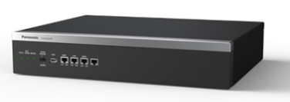
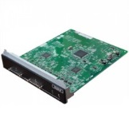
2-2. System Configuration(15)
V2
New model Legacy GW-BOX (KX-NS1000**G)
This model is an expansion box only for KX-NSX series PBX. Its functionality is the same as a KX-NS1000 connected as an expansion gateway.
The "**" in "KX-NS1000**G" indicates the suffix for each area (e.g., KX-NS1000NEG).
Initial install items
Hardware
DSP-S
STACK-M
Activation Key
Router
Expansion GW
Physical cards that are supported by the KX-NS1000 PBX are also supported by the NSX Expansion Box.
The NSX Expansion Box supports the same equipment as the KX-NSX series PBX.
New model Stacking-S card
Compatible GW box
• KX-TDE600/620
• KX-TDA600/620
• KX-TDA100D
This model NS0132**G only for NS1000**G.
For details about supported optional service cards and Power Supply Units (PSUs) with Legacy Gateways, refer to the Installation Manual of the corresponding PBX.

Slide 67
Chapter 3
Supported Card/Terminal

Slide 68
3-1. Specification(1)
Optional items for NSX
The table of Optional Items:
Item | Model | Name | Function Summary | Remarks
DSP-S | KX-NS0110 | VOIP DSP-S card | VOIP, DISA, Conference & Unified Messaging | Same DSP for NS1000
DSP-M | KX-NS0111 | VOIP DSP-M card | VOIP, DISA, Conference & Unified Messaging | Same DSP for NS1000
DSP-L | KX-NS0112 | VOIP DSP-L card | VOIP DISA, Conference & Unified Messaging | Same DSP for NS1000
SSD-S | KX-NSX2135 | Solid State Drive module S-size | VM recording time:200H
SSD-M | KX-NSX2136 | Solid State Drive module M-size | VM recording time:400H
SSD-L | KX-NSX2137 | Solid State Drive module L-size | VM recording time:800H
SSD-LL | KX-NSX2138 | Solid State Drive module LL-size | VM recording time:1600H
AC cable | KX-A412 | AC cable | Optional AC cable
Notes

Slide 69
3-1. Specification(2)
Virtual cards included with the Mother board
The table of Virtual Cards:
Card Type | Notes
V-IPGW128 Virtual 128 channel VoIP Gateway Card | Virtual Card for 128 channel H.323 trunk.
V-SIPGW128 Virtual 128 channel SIP Trunk Card | Virtual Card for 128 channel SIP trunk.
V-IPEXT128 Virtual 128 channel VoIP Extension Card | Virtual Card for 128 VoIP extensions. Compliant with Panasonic IP-PTs and IP-softphones.
V-SIPEXT128 Virtual 128 channel SIP Extension Card | Virtual Card for 128 SIP phones.
V-IPCS16 Virtual 16 channel Cell Station Card | Virtual Card for 16 channel CS.
Notes:
69

Slide 70
3-2. Terminal Compatibility (1)
The table of IP Terminals:
 |  | Model | Description | Remarks
IP-PT | NT300 | NT3XX series |  | Only available on expansion GW
 | NT500 | KX-NT560 | 4.4 inch Graphical LCD and Desi-less
 |  | KX-NT546 | 6 line LCD, 24 FF key
 |  | KX-NT543 | 3 line LCD, 24 FF key
 |  | KX-NT556 | 6 line Graphical LCD,36 FF key
 |  | KX-NT553 | 3 line Graphical LCD, 24 FF key
 |  | KX-NT551 | 1 line 16 characters LCD, 8 FF key
 |  | KX-NT511 | 1 line 16 characters LCD, 3 FF key
 |  | KX-NT505 | 48 Flexible button (Max. 4 DSS connection with IP-PT by proprietary cable)
 | HDV | KX-HDV100 | LCD (132 x 64 pixel graphical), 2 programmable key | limited service same level as 3rd party SIP phone
 |  | KX-HDV130 | LCD(132 x 64 pixel graphical),2 programmable key | limited service same level as 3rd party SIP phone
 |  | KX-HDV230 | LCD(132 x 64 pixel graphical),24 programmable key | limited service same level as 3rd party SIP phone
 |  | KX-HDV330 | LCD (4.3 inch color touch panel),24 programmable key | (TBD) limited service same level as 3rd party SIP phone
 |  | KX-HDV430 | LCD (4.3 inch color touch panel),24 programmable key | (TBD) limited service same level as 3rd party SIP phone
 | TGP | KX-TGP600 | SIP cordless phone | limited service same level as 3rd party SIP phone
Notes:
70

Slide 71
3-2. Terminal Compatibility (2)
The table of IP Terminals:
 |  | Model | Description | Remarks
IP Conference Phone |  | KX-NT700 | SIP Conference Telephone | As 3rd party SIP phone
Communication IP Camera |  | KX-NTV150 | Communication IP Camera
 |  | KX-NTV160 | Video Door phone
Soft-phone |  | - | IP Soft phone
Cell Station (CS) | IP-CS | KX-NS0154 | IP 4ch CS for DECT/DECT 6.0 handset *Able to expand 4ch to 8ch with activation key.

Slide 72
3-2. Terminal Compatibility (3)
The table of Legacy Terminals:
 |  | Model | Description | Remarks
DPT | DT300 | DT346 | 6 line LCD, 24 FF key
 |  | DT343 | 3 line LCD, 24 FF key
 |  | DT333 | 3 line LCD, 24 FF key
 |  | DT321 | 1 line LCD, 8 FF key
 |  | DT390 | DSS console
 | DT500 | DT546 | 6 line LCD, 24 FF key
 |  | DT543 | 3 line LCD, 24 FF key
 |  | DT521 | 1 line LCD, 8 FF key
 |  | DT590 | DSS console
APT |  | T77XX series | ( DHLC4 is needed )
PS | DECT | TCA175, TCA275, WT115, TCA185,TCA285TCA385,TCA364 | DECT handset
 | DECT6.0 | TD7685,TD7695, TD7696 | DECT handset
CS | DECT | KX-TDA0155CE | 2 ch CS Using DLC Card
 |  | KX-TDA0158CE | 8 ch CS Using DLC Card
 | DECT6.0 | KX-T0155 | 2 ch CS Using DLC Card
 |  | KX-T0158 | 8 ch CS Using DLC Card
Doorphone |  | KX-T30865 | Door Phone
 |  | KX-T7765 | Door Phone
Notes:
DECT PS count as EXT
So MAX EXT include DECT PS.

Slide 73
3-2. Terminal Compatibility (4)
The table of Unsupported Terminals:
Type | Devices/Applications | Remarks
IP-terminal | KX-NT265,KX-NT400, KX-HGT100
 | KX-UDS/UDT (SIP based DECT) (UDS124,UDT111/121/131)
 | KX-UTseries SIP phone (UT113/123/136/133/248/670) ^{*1} | *1 : UT series SIP phones can be connected as 3rd party SIP phone and used limited service as 3rd party SIP phone. SIP extension activation key is required.
DECT-PS | TCA155,TCA256,TCA355
IP-CS | NCP0158
Legacy terminal | DPT:KX-T7600/T7500/T7400/T7300/T7200 series
 | 2.4G PS:KX-TD7684/7694 etc.
 | CS for 2.4G PS: KX-TDA0141/TDA0142/TDA151/TDA152
 | CS for DECT: DECT: KX-TDA0141CE/TDA0142CE/TDA0156CE/TDA0156
Voicemail | KX-TVM200/TVM50, KX-TVA200/TVA50
Application | CA
Stacked PBX for NS1000 | NCP500/1000, NS1020 TDA100/200,TDE100/200 | For expansion GW

Slide 74
3-3. Trunk Adaptor Compatibility
The table of Trunk Adaptors:
Model | Name | Description | Remarks
KX-NS8188X | E1 Trunk Adaptor | 1 E1 Interface
KX-NS8290CE | PRI Adaptor(30ch) | 1 PRI(30ch) Interface Support Public line and Private line
KX-NS8290 | PRI Adaptor(23ch) | 1 PRI(23ch) Interface Support Public line and Private line
Note: Trunk adaptors cannot be supported on NS300/500/700 as the expansion gateway.

Slide 75
3-4. Physical card Compatibility for Legacy Gateways (1)
The table of Unsupported Physical cards:
Model | Description | Remarks
KX-TDA0105 | Memory Expansion card (MEC)
KX-TDA0191 | 4-Channel Message Card (MSG4)
KX-TDA0192 | 2-Channel Simplified Voice Message Card (ESVM2)
KX-TDA0194 | 4-Channel Simplified Voice Message Card (ESVM4)
KX-TDA0196 | Remote Card (RMT)
KX-TDA0410 | CTI Link Card (CTI-LINK)
KX-TDA0470 | 16-Channel VoIP Extension Card (IP-EXT16)
KX-TDA0480 | 4-Channel VoIP Gateway Card (IP-GW4)
KX-TDA0484 | 4-Channel VoIP Gateway Card (IP-GW4E)
KX-TDA0490 | 16-Channel VoIP Gateway Card (IP-GW6)

Slide 76
3-4. Physical card Compatibility for Legacy Gateways (1)
The table of Unsupported Physical cards:
Model | Description | Remarks
KX-TDA0143 | 4 Cell Station Interface Card (CSIF4)
KX-TDA0144 | 8 Cell Station Interface Card (CSIF8)
KX-TDE0110 | 16-Channel VoIP DSP Card (DSP16)
KX-TDE0111 | 64-Channel VoIP DSP Card (DSP64)

Slide 77
Chapter 4
System Capacity

Slide 78
4-1. System Capacity (1)
 |  |  |  | NSX1000 |  | NSX2000
 |  |  |  | Stand-alone | Multi- connection | Stand-alone | Multi- connection
User |  |  |  | 1000 | 1000 | 2000 | 2000
Device for User (Extension) (pcs) |  |  |  | 1000 | 1000 | 2000 | 2000
Total Device Number can’t beyond Max User number | Wired device (psc) |  |  | 1000 | 1000 | 2000 | 2000
 |  | IP device (pcs) |  | 1000 | 1000 | 2000 | 2000
 |  |  | IP-PT(NT3*/NT5* series) ^{*2} HDV series TGP600 | 1000 | 1000 | 2000 | 2000
 |  |  | SIP phone(3rd party) | 1000 | 1000 | 2000 | 2000
 |  |  | Communication Camera / IP Doorphone *3 | 128 | 128 | 128 | 128
 |  | Legacy device (pcs) |  | 0 | 1000 | 0 | 2000
 |  |  | SLT | 0 | 1000 | 0 | 2000
 |  |  | DPT *1 | 0 | 512(1000) | 0 | 1024(2000)
 |  |  | APT | 0 | 320 | 0 | 640
 |  | DSS console |  | 0 | 128 | 0 | 128
 | PS (pcs) |  |  | 1000 | 1000 | 1000 | 1000
 | Mobile number in user container |  |  | 1000 | 1000 | 2000 | 2000
*1: () means that It is the case of using DXDP connection. Other number does not include the DXDP connection. If User uses DXDP, the maximum number depends on the gateway system.
*2：KX-NT3* series cannot be supported on NSX1000/2000. It is supported only on expansion gateways in multi connection system.
*3: Communication camera and IP doorphone are not counted as number of users.
Notes:
DECT PS count as EXT
So MAX EXT include DECT PS.

Slide 79
4-1. System Capacity (2)
 |  |  | NSX1000 |  | NSX2000
 |  |  | Stand-alone | Multi- connection | Stand-alone | Multi- connection
Add-on Key Module(NT505) (pcs) |  |  | 64 | 64 | 128 | 128
Add-on Key Module(NT303,305) (pcs) |  |  | 1000 | 1000 | 2000 | 2000
CS |  |  | 256 | 256 | 256 | 256
 |  | IP-CS (pcs) | 256 | 256 | 256 | 256
 |  | CS(DPT-CS) (pcs) | 0 | 256 | 0 | 256
Trunk |  |  | 640 | 640 | 960 | 960
 | IP Trunk (ch) |  | 640 | 640 | 960 | 960
 |  | SIP Trunk | 640 | 640 | 960 | 960
 |  | H.323 Trunk | 256 | 256 | 256 | 256
 | Legacy Trunk (ch) |  | 0 | 640 | 0 | 960
 |  | LCOT | 0 | 640 | 0 | 960
 |  | BRI | 0 | 640 | 0 | 960
 |  | PRI23 | 0 | 640 | 0 | 960
 |  | PRI30 | 0 | 640 | 0 | 960
 |  | T1 | 0 | 640 | 0 | 960
 |  | E1 | 0 | 640 | 0 | 960
Other I/O
 | Doorphone |  | 0 | 124 | 0 | 124
 | Opener |  | 0 | 124 | 0 | 124
 | Sensor |  | 0 | 124 | 0 | 124
AKs for user that are registered in Exp. GW should be installed in Master unit

Slide 80
4-1. System Capacity (3)
System Resource
Category | Item | Max. Number |  | Remarks
 |  | NSX1000 | NSX2000
System | Operator | 4/System 4/Tenant | 4/System 4/Tenant
 | Call Park Zone | System:100 Each tenant:100 | System:100 Each tenant:100
 | Conference | 3-32 parties (256parties total) | 3-32 parties (256parties total)
 | Class of Service (COS) | 512 | 512
 | DID/DDI Table | 32 digits, 7000 entries | 32 digits, 7000 entries
 | Extension number | 1-5 digits (PSs: 1-4 digits) | 1-5 digits (PSs: 1-4 digits)
 | Host PBX Access Code | 10 per trunk group (10 digits) | 10 per trunk group (10 digits)
 | Number of Character of Name | 20 | 20
 | Printing message | 8 | 8
 | Queuing Time Table | 256 | 256
 | Ring Tone Pattern Plan | 8 | 8
 | SMDR Call Storage | 160000calls | 160000 calls
 | Charge Record for Hotel | 40000calls | 40000 calls
 | Special Carrier Access Code | 16 digits, 100 entries | 16 digits, 100 entries
 | Tenant | 128 | 128
 | Time Service Holiday | 24 | 24
 | Verification Code | 2000 (4 digits) | 2000 (4 digits)
 | Verification Code PIN | 2000 (10digits) | 2000 (10digits)

Slide 81
4-1. System Capacity (4)
System Resource
Category | Item | Max. Number |  | Remarks
 |  | NSX1000 | NSX2000
Dialing | Emergency Call entries | 20 | 20
 | Personal Speed Dialing | 100/Extension | 100/Extension
 | Quick Dialing | System:3000 +1000/Tenant | System:3000 +1000/Tenant
 | System Speed Dialing | System：33000 Max1000/Tenant | System：33000 Max1000/Tenant
Group | Conference Call Group | 48 | 48
 | Call Pickup Group | 200 | 200
 | Idle Extension Hunting Group | 256 | 256
 | Incoming Call Distribution Group | 256 (128 extensions/group) | 256 (128 extensions/group)
 | Paging Group | 200 | 200
 | PS Ring Group | 32 | 32
 | Trunk Group | 128 | 128
 | IP-CS LAN sync. Group | 32 (64 IP-CS/group) | 32 (64 IP-CS/group)
 | IP-CS Air sync. group | 16 (16 IP-CS/group) | 16 (16 IP-CS/group)
TRS/Barring | TRS/Barring level | 7 | 7
 | TRS/Barring Denied Code | 600/level | 600/level
 | TRS/Barring Exception Code | 600/level | 600/level

Slide 82
4-1. System Capacity (5)
System Resource
Category | Item | Max. Number |  | Remarks
 |  | NSX1000 | NSX2000
ARS | Routing Plan Table | 240 | 240
 | Leading number Table | 5000 | 5000
 | Leading number Exception Table | 1000 | 1000
 | ARS Carrier | 128 | 128
Call Log and Message Waiting | Outgoing Call Log (User base) | 100/user, 10000/system | 100/user, 10000/system
 | Incoming Call Log-PT(User base) | 100/user, 20000/system | 100/user, 20000/system
 | Incoming Call Distribution Group | 10240/system | 10240/system
 | Message Waiting-PS + Incoming Call Distribution Group | 1000 | 2000
 | Message Waiting-PT +SLT | 1000 | 2000
OGM | Outgoing Message(OGM) | 128 | 128
 | OGM Port | 128 | 128
 | OGM Total recording time | 64min | 64min

Slide 83
4-1. System Capacity (6)
System Resource
Category | Item | Max. Number |  | Remarks
 |  | NSX1000 | NSX2000
Unified Message | Number of Mailboxes | 1608 | 2608
 | Max. Recording time | 1600h | 1600h | SSD-LL
 | Maximum Message Length | 1 - 60 min (programmable) Unlimited for two-way recording | 1 - 60 min (programmable) Unlimited for two-way recording
 | Number of Chanel for UM | 128ch | 128ch
 | Number of Chanel for FAX | 31ch | 31ch | Need fax card and NS1000
 | Number of Chanel for IMAP | 72ch | 72ch
 | Length of Personal Greeting | Max:360s | Max:360s
 | Custom Service | 200/Tenant | 200/Tenant
Call Center | Super visor | 32 | 32
 | Auto 2way Rec Manager | 96 | 96
 | Number of Call log for ACD report | 1200000 | 1200000

Slide 84
4-2. Expansion GW Capacity (1)
NS1000 as Expansion GW
Type of stacking PBX # of stacking PBX |  |  |  | NS1000
 |  |  |  |  | TDA100D |  | TDA600/620, TDE600/620
 |  |  |  | Stand- alone | 1 | 2 | 1 | 2
User |  |  |  | (Not depend on the gateway, see system capacity)
Device for User (Extension) (pcs) |  |  |  | (Not depend on the gateway, see system capacity)
 | Wired device (pcs) |  |  | 640 | 640 |  | 640
 |  | IP device (pcs) |  | 640 | 640 |  | 640
 |  |  | IP-PT(NT3/NT5 series) HDV series TGP600 | 640 | 640 |  | 640
 |  |  | SIP phone(3rd party) | 256 | 256 |  | 256
 |  |  | Communication Camera / IP Doorphone | 128 | 128 |  | 128
 |  | Legacy device (pcs) |  | 2 | 128 | 256 | 240 | 480
 |  |  | SLT | 2 | 128 | 256 | 240 | 480
 |  |  | DPT | 0 | 112 | 224 | 160 | 320
 |  |  | APT | 0 | 0 | 0 | 80 | 160
 |  | DSS console (pcs) |  | 0 | 8 | 16 | 64 | 64
 | PS (pcs) |  |  | (Not dependent on the gateway, see system capacity)
 | Mobile number in user container |  |  | (Not dependent on the gateway, see system capacity)
Notes:
84

Slide 85
4-2. Expansion GW Capacity (2)
NS1000 as Expansion GW
Type of stacking PBX # of stacking PBX |  |  | NS1000
 |  |  |  | TDA100D |  |  | TDA600/620, TDE600/620
 |  |  | Stand- alone | 1 | 2 |  | 1 | 2
Add-on Key Module(NT505) (pcs) |  |  | (Not dependent on the gateway, see system capacity)
Add-on Key Module(NT303,305) (pcs) |  |  | (Not dependent on the gateway, see system capacity)
CS |  |  | 256 | 256 |  | 256
 | IP-CS (pcs) |  | (Not dependent on the gateway, see system capacity)
 | CS(DPT-2ch CS) (pcs) |  | 0 | 32 |  |  | 32
Trunk (ch) |  |  | 256 | 256 |  |  | 256
 | IP Trunk (ch) |  | 256 | 256 |  |  | 256
 |  | SIP Trunk | 256 | 256 |  |  | 256
 |  | H.323 Trunk | 48 | 48 |  |  | 48
 | Legacy Trunk (ch) |  | 30 | 120 | 240 |  | 160 | 256
 |  | LCOT | 2 | 112 | 224 |  | 160 | 256
 |  | BRI | 8 | 112 | 224 |  | 160 | 256
 |  | PRI23 | 23 | 92 | 184 |  | 115 | 230
 |  | PRI30 | 30 | 120 | 240 |  | 150 | 256
 |  | T1 | 0 | 96 | 192 |  | 120 | 240
 |  | E1 | 0 | 120 | 240 |  | 150 | 256
Other I/O
 | Doorphone |  | 1 | 17 | 33 |  | 17 | 33
 | Opener |  | 1 | 17 | 33 |  | 17 | 33
 | Sensor |  | 1 | 17 | 33 |  | 17 | 33

Slide 86
4-2. Expansion GW Capacity (3)
NS700 as Expansion GW
 |  |  |  | NS700
 |  |  |  | Basic unit | Basic unit w/1Exp.unit | Basic unit w/2Exp.unit | Basic unit w/3Exp.unit
User |  |  |  | (Not dependent on the gateway, see system capacity)
Device for User (Extension) (pcs) |  |  |  | (Not dependent on the gateway, see system capacity)
 | Wired device (pcs) |  |  | 166 | 198 | 230 | 262
 |  | IP device (pcs) |  | 128
 |  |  | IP-PT(NT3/NT5 series) HDV series TGP600 | 128
 |  |  | SIP phone(3rd party) | 128
 |  |  | Communication Camera / IP Doorphone | 128
 |  | Legacy device (pcs) |  | 38 | 70 | 102 | 134
 |  |  | SLT | 36 | 68 | 100 | 132
 |  |  | DPT | 34 | 66 | 98 | 130
 |  |  | APT | 8 | 16 | 24 | 32
 |  | DSS console |  | 8 | 8 | 8 | 8
 | PS (pcs) |  |  | (Not dependent on the gateway, see system capacity)
 | Mobile number in user container |  |  | (Not dependent on the gateway, see system capacity)

Slide 87
4-2. Expansion GW Capacity (4)
NS700 as Expansion GW
 |  |  | NS700
 |  |  | Basic unit | Basic unit w/1Exp.unit | Basic unit w/2Exp.unit | Basic unit w/3Exp.unit
Add-on Key Module(NT505) (pcs) |  |  | (Not dependent on the gateway, see system capacity)
Add-on Key Module(NT303,305) (pcs) |  |  | (Not dependent on the gateway, see system capacity)
CS |  |  | 256
 | IP-CS (pcs) |  | (Not dependent on the gateway, see system capacity)
 | CS(DPT-2ch CS) (pcs) |  | 8 | 16 | 24 | 32
Trunk (ch) |  |  | 102 | 138 | 174 | 210
 | IP Trunk (ch) |  | 64
 |  | SIP Trunk | 64
 |  | H.323 Trunk | 32
 | Legacy Trunk (ch) |  | 38 | 74 | 110 | 146
 |  | LCOT | 12 | 24 | 36 | 48
 |  | BRI | 16 | 32 | 48 | 64
 |  | PRI23 | 23 | 46 | 69 | 92
 |  | PRI30 | 30 | 60 | 90 | 120
 |  | T1 | 0 | 0 | 0 | -
 |  | E1 | 30 | 60 | 90 | 120
Other I/O
 |  | Doorphone | 2 | 4 | 6 | 8
 |  | Opener | 2 | 4 | 6 | 8
 |  | Sensor | 2 | 4 | 6 | 8

Slide 88
4-2. Expansion GW Capacity (5)
NS500 as Expansion GW
 |  |  |  | NS500
 |  |  |  | Basic unit | Basic unit w/1Exp.unit | Basic unit w/2Exp.unit | Basic unit w/3Exp.unit
User |  |  |  | (Not dependent on the gateway, see system capacity)
Device for User (Extension) (pcs) |  |  |  | (Not dependent on the gateway, see system capacity)
 | Wired device |  |  | 162 | 194 | 226 | 258
 |  | IP device |  | 128
 |  |  | IP-PT(NT3/NT5 series) HDV series TGP600 | 128
 |  |  | SIP phone(3rd party) | 128
 |  |  | Communication Camera /IP Doorphone | 128
 |  | Legacy device (pcs) |  | 34 | 66 | 98 | 130
 |  |  | SLT | 32 | 64 | 96 | 128
 |  |  | DPT | 18 | 34 | 50 | 66
 |  |  | APT | 8 | 16 | 24 | 32
 |  | DSS console |  | 8 | 8 | 8 | 8
 | PS (pcs) |  |  | (Not dependent on the gateway, see system capacity)
 | Mobile number in user container |  |  | (Not dependent on the gateway, see system capacity)

Slide 89
4-2. Expansion GW Capacity (6)
NS500 as Expansion GW
 |  |  | NS500
 |  |  | Basic unit | Basic unit w/1Exp.unit | Basic unit w/2Exp.unit | Basic unit w/3Exp.unit
Add-on Key Module(NT505) (pcs) |  |  | (Not dependent on the gateway, see system capacity)
Add-on Key Module(NT303,305) (pcs) |  |  | (Not dependent on the gateway, see system capacity)
CS |  |  | 256
 |  | IP-CS (pcs) | (Not dependent on the gateway, see system capacity)
 |  | CS(DPT-2ch CS) (pcs) | 4 | 8 | 12 | 16
Trunk (ch) |  |  | 100 | 136 | 172 | 208
 | IP Trunk (ch) |  | 64
 |  | SIP Trunk | 64
 |  | H.323 Trunk | 32
 | Legacy Trunk (ch) |  | 36 | 72 | 108 | 144
 |  | LCOT | 12 | 24 | 36 | 48
 |  | BRI | 8 | 24 | 40 | 56
 |  | PRI23 | 23 | 46 | 69 | 92
 |  | PRI30 | 30 | 60 | 90 | 120
 |  | T1 | 0 | 0 | 0 | 0
 |  | E1 | 30 | 60 | 90 | 120
Other I/O
 | Doorphone |  | 2 | 4 | 6 | 8
 | Opener |  | 2 | 4 | 6 | 8
 | Sensor |  | 2 | 4 | 6 | 8

Slide 90
4-2. Expansion GW Capacity (7)
NS300 as Expansion GW
 |  |  |  | NS300
 |  |  |  | Basic unit | Basic unit w/1Exp.unit | Basic unit w/2Exp.unit | Basic unit w/3Exp.unit
User |  |  |  | (Not dependent on the gateway, see system capacity)
Device for User (Extension) (pcs) |  |  |  | (Not dependent on the gateway, see system capacity)
 | Wired device (pcs) |  |  | 66 | 98 | 130 | 162
 |  | IP device |  | 32
 |  |  | IP-PT(NT3/NT5 series) HDV series TGP600 | 32
 |  |  | SIP phone(3rd party) | 32
 |  |  | Communication Camera / IP Doorphone | 32
 |  | Legacy device (pcs) |  | 34 | 66 | 98 | 130
 |  |  | SLT | 32 | 64 | 96 | 128
 |  |  | DPT | 18 | 34 | 50 | 66
 |  |  | APT | 8 | 16 | 24 | 32
 |  | DSS console (pcs) |  | 8 | 8 | 8 | 8
 | PS (pcs) |  |  | (Not dependent on the gateway, see system capacity)
 | Mobile number in user container |  |  | (Not dependent on the gateway, see system capacity)

Slide 91
4-2. Expansion GW Capacity (8)
NS300 as Expansion GW
 |  |  |  | NS300
 |  |  |  | Basic unit | Basic unit w/1Exp.unit | Basic unit w/2Exp.unit | Basic unit w/3Exp.unit
Add-on Key Module(NT505) (pcs) |  |  |  | (Not depend on the gateway, see system capacity)
Add-on Key Module(NT303,305) (pcs) |  |  |  | (Not depend on the gateway, see system capacity)
CS |  |  |  | 256
 | IP-CS (pcs) |  |  | (Not dependent on the gateway, see system capacity)
 | CS(DPT-2ch CS) (pcs) |  |  | 4 | 8 | 12 | 16
Trunk (ch) |  |  |  | 52 | 88 | 124 | 160
 | IP Trunk (ch) |  |  | 16
 |  | SIP Trunk |  | 16
 |  | H.323 Trunk |  | 16
 | Legacy Trunk (ch) |  |  | 36 | 72 | 108 | 144
 |  |  | LCOT | 12 | 24 | 36 | 48
 |  |  | BRI | 8 | 24 | 40 | 56
 |  |  | PRI23 | 23 | 46 | 69 | 92
 |  |  | PRI30 | 30 | 60 | 90 | 120
 |  |  | T1 | 0 | 0 | 0 | 0
 |  |  | E1 | 30 | 60 | 90 | 120
Other I/O
 | Doorphone |  |  | 2 | 4 | 6 | 8
 | Opener |  |  | 2 | 4 | 6 | 8
 | Sensor |  |  | 2 | 4 | 6 | 8

Slide 92
Chapter 5
Hardware Installation

Slide 93
5-1. Before Installation
Unpack the package and check the package contents.
Package Contents
Content |  | Number
Main Unit |  | 1
CD-ROM (including manuals, etc.) |  | 1
19-inch Rack Attachment Bracket |  | 2
Hook Clip |  | 1
Screw |  | 6

Slide 94
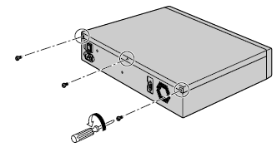
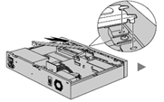


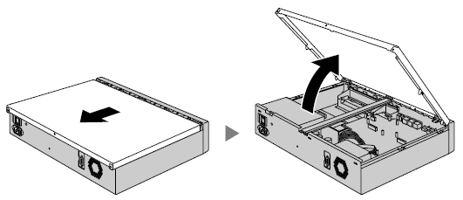
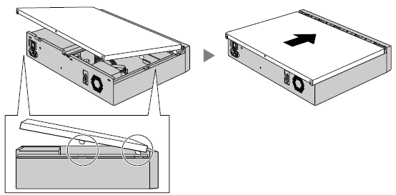
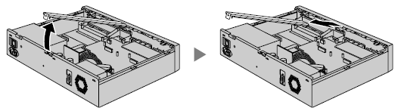
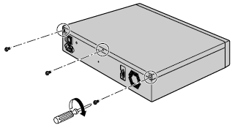
5-2. Main Unit Installation
Open / Close the Top Cover before installation.
Opening the Top Cover
Closing the Top Cover
1. Turn the screws anticlockwise to loosen.
\
1. Place the support bar onto the PBX.
2. Slide the top cover then lift it off.
2. Place the top cover onto the PBX.
Then slide the top cover until it closes properly.
3. Remove the support bar from the PBX.
3. Turn the screws clockwise to tighten.

Slide 95
5-2. Main Unit Installation
Frame Earth Connection.
1. Loosen the screw.
2. Insert an earthing wire (user-supplied).
3. Tighten the screw.
4. Connect the earthing wire to earth.
WARNING
Proper earthing (connection to earth) is very important to reduce the risk to the user of
electrocution or to protect the PBX from the bad effects of external noise in the case of
a lighting strike.
The earthing wire of the AC cable has an effect against external noise and lighting strikes,
but it may not be enough to protect the PBX and to ensure electromagnetic compatibilety.
A permanent connection between earth and the earth terminal of the PBX must be made.
CAUTION
For earthing wire, green-and-yellow insulation is required, and the cross-sectional area of
the conductor must be more than 0.75 mm² or 18AWG.
Notes:
95

Slide 96
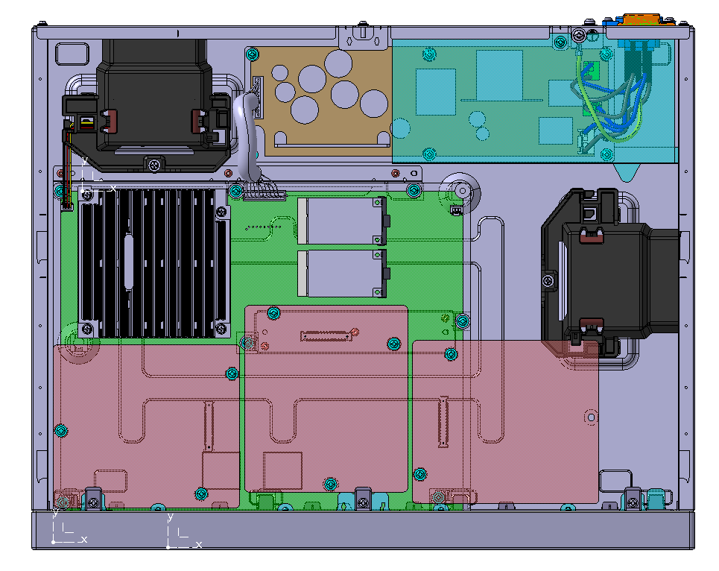
5-3. Optional Cards Installation
Install the optional cards in the appropriate slot.
CAUTION
When installing or removing the optional cards,
the power switch must be turned off.
Mother Board
DSP Card (Option）
Front
side
SSD Card (Option)
SSD Card
(initial mount)
CPU Card
(initial mount）

Slide 97

5-4. Mounting Method
19-inch Rack Mounting
Attachment Bracket ^{*1}
*1 Only use the 19-inch rack mounting equipment (attachment bracket, screws) included with the PBX.

Slide 98
Appendix

Slide 99

Installer Profile
Installer Profile under “Maintenance Information-1.Installer Information”

Slide 100
Thank you ! The END

Slide 101
Modification
1.0_NSX1000_2000_Overview_Rev1.0_09Jun2015.pptx
- 1st release
1.0_NSX1000_2000_Overview_Rev1.1_05Aug2015.pptx
-Slide 16, 20, 22, 25, 27, 31 and 33
Slide 23 delete V1 information and add description
1.0_NSX1000_2000_Overview_Rev1.2_17Sep2015.pptx
-All slides are changed character size and adjust the position
1.0_NSX1000_2000_Overview_Rev1.3_19Oct2015.pptx
-Add Slide 24 Type of data to be transferred
-Add Slide 42, 43 additional new feature for V2
-Add Slide 56 Explain annual AK period
-Add remarks for Stacking box at Slide 66
-Add un-supported physical card table at Slide 75 and 76
1.0_NSX1000_2000_Overview_Rev2.0_19Apr2016.pptx
-Adopt with V2 features

Slide 102
Modification
1.0_NSX1000_2000_Overview_Rev2.1_17May2016.pptx
-Slide 7 delete NT300, UPS
- Add description for AK activation
- Delete UPS description for USB
- Add description at Slide 59
1.0_NSX1000_2000_Overview_Rev2.2_1June2016.pptx
- Slide 10 condition for DECT-PS is added
1.0_NSX1000_2000_Overview_Rev2.3_1Sep2016.pptx
- Slide 46/51 delete UPS description
- Change description at 59
1.0_NSX1000_2000_Overview_Rev2.4_20Sep2016.pptx
base, adopted initial capacity NSX1000 to Europe
- Change description at 59

