Slide 1
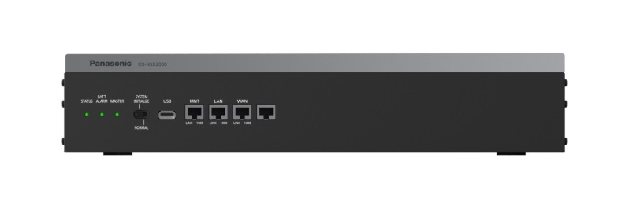





KX-NSX1000/2000
Networking
Rev2.4 17 Oct., 2016
Notes:
1

Slide 2
Table of Contents
Chapter1 Overview
Chapter2 How it work?
Chapter3 How to program?

Slide 3
Chapter 1
Overview

Slide 4



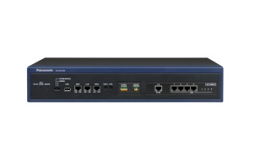

1. Overview
1.Stand-alone System
- A single KX-NSX1000/2000 can be used as a stand-alone system.
- A single KX-NSX1000/2000 controls all terminals, trunks and applications.
2.Networked System
KX-NSX1000/2000 provides two methods of private networking;
- Multi-Connection Network (A network protocol only used for Panasonic products)
- QSIG Networking (via ISDN and H.323)
Master Unit
Up to 31 NS Units
IP Network
・・・
Use NS1000/700/500/300 as Expansion GW.
In addition 31 Legacy GW / Expansion Unit
can be connected.
Notes:
Master has to be NSX.
NSX can’t be slave.
NS can be slave(Expansion GW)
Legacy GW can be
TDE/TDA600/620
TDA100D
only.
NSX can support IP device only

Slide 5
1. Overview
Expansion Gateways
KX-NS1000/700/500/300 can be Expansion Gateway.
It is necessary to update firmware of NS main to be a Expansion Gateway.
KX-NS1000/700/500/300 can be role back to standard NS firmware.
Maximum number of Expansion GW = 31
1 stacked cabinet to NS1000, 1 NS320/520/720 is counted as 1 Legacy GW
(No need NSF991 AK for NS700)
TDA600/620, TDE600/620, TDA100D can be stacked to NS1000

Slide 6
1. Overview
Expansion Gateways and Stacked PBX
Each expansion gateway can be have legacy gateways or expansion units as follows.
Expansion Gateway | Max. Number of stacked PBX (legacy GW / expansion unit) | Available stacked PBX (legacy GW / expansion unit) | Max. stacking number on Multi-connection
NS1000 | 2 stacked PBXs | TDE600/620 TDA600/620 TDA100D | 31
NS700 | 3 expansion units | NS720
NS500 | 3 expansion units | NS520
NS300 | 3 expansion units | NS320

Slide 7





1. Overview
Expansion Gateways and Stacked PBX
NSX1000 and NSX2000 cannot be assigned as expansion gateways.
And they cannot work under other NSX1000/2000 as expansion gateway.
Up to 31 expansion gateways
NSX1000/2000
NS1000
NS700/500/300
NS1000
NS700/500/300
TDE600/620
TDA600/620
TDA100D
NS720/520/320
Up to 31 legacy gateways and expansion units

Slide 8

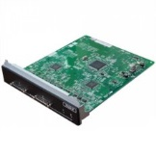
1. Overview
V2
Expansion BOX (KX-NS1000**G)
This model is an expansion box only for KX-NSX series PBX. Its functionality is the same as a KX-NS1000 connected as an expansion gateway.
The "**" in "KX-NS1000**G" indicates the suffix for each area (e.g., KX-NS1000NEG).
Initial install items
Hardware
DSP-S
STACK-M
Activation Key
Router
Expansion GW
Physical cards that are supported by the KX-NS1000 PBX are also supported by the NSX Expansion Box.
The NSX Expansion Box supports the same equipment as the KX-NSX series PBX.
New model Stacking-S card
Compatible GW box
• KX-TDE600/620
• KX-TDA600/620
• KX-TDA100D
This model NS0132**G only for NS1000**G.
For details about supported optional service cards and Power Supply Units (PSUs) with Legacy Gateways, refer to the Installation Manual of the corresponding PBX.

Slide 9
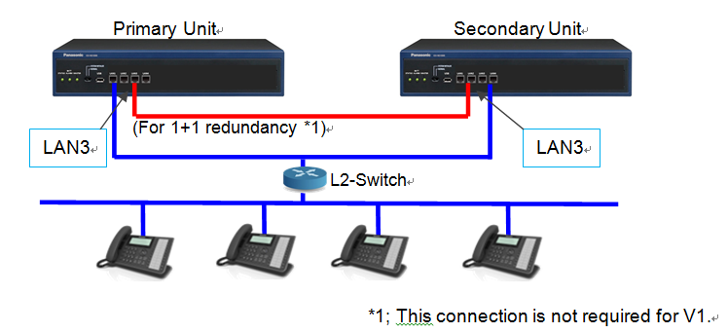

1. Overview
V2
1+1 redundancy
LAN3
Following activation keys are required for the secondary unit apart from
the primary’s ones.
1)System Activation Key
(KX-NSX101/ KX-NSX201)[Mandatory]
2)Maintenance annual Key
(KX-NSX2201) [Mandatory]
3)Remote Maintenance annual
Key(KX-NSX6211) [Strongly Recommended]
While Secondary NSX become active and if there is no Remote AK then Secondary NSX can’t be accessible remotely.
LAN1/2
LAN1/2
Switch
Automatically switch to Secondary while detecting primary failure. This can be deployed by additional
LAN connection through “LAN3”.
System data is transferred periodically and while data has changed from Primary to Secondary.
The maximum length for a cable for LAN3 is 100 m ( Cat5e or higher )
Redundancy AK is required on Primary only.
Notes:
LAN1/2 for regular LAN connection
LAN3 for Data transfer

Slide 10

1. Overview
Survival gateway feature (Simplified Isolated mode)
Expansion gateway will be in “Simplified Isolated Mode” in case of,
NSX Master can’t be detected during starting up or running as Expansion GW
Manually switch to “Simplified Isolated Mode”
There is basic operation only such as outgoing and incoming call during this mode.
“Simplified Isolated Mode” can be continued for 30 days.
The mode is expired after 30 days. When 30 days passed all services are stopped until switching back to normal mode.
“Simplified Isolated Mode” can be released either manual operation, scheduled or automatic.
ExpGW1
“Simplified Isolated Mode”
Notes:
Completely Different
feature from
Isolated mode of NS1000

Slide 11



1. Overview
V2
Multiple LAN network support
One NSX1000/2000 support multiple SIP provider and multiple LAN segment
External
NW
SIP carrier 1
SIP carrier 2
Internal LAN
NAT
NAT
NSX1000/NSX2000
L3-switch
Default GW of NSX1000/2000 is L3-switch
There is only 1 NAT Traversal rule can be set in the past.
8 different NAT Traversal rule settings can be set.
So up to 8 multiple SIP carrier can be supported even all of them need individual NAT Traversal rule.

Slide 12
Chapter 2
How it work?

Slide 13
2. How it work?
V2
1+1 redundancy
Automatic Switch over
by own method
Secondary Unit
Automatic Data Transfer
by LAN3 connection
LAN3
LAN3
LAN1/2
LAN1/2
Switch
AK
Temp AK
IP phones recognize Secondary Unit
as same PBX thus same IP address.
Expansion GW
restart and
reconnect to Secondary.
System, Maintenance, Remote(Optional) AK required to Secondary Unit.
Other than this 30 days Temporary AK deployed
Notes:
Both NSX unit recommended to
connect same SW.
LAN3 connection for Data Transfer
LAN1/2 for normal operation

Slide 14
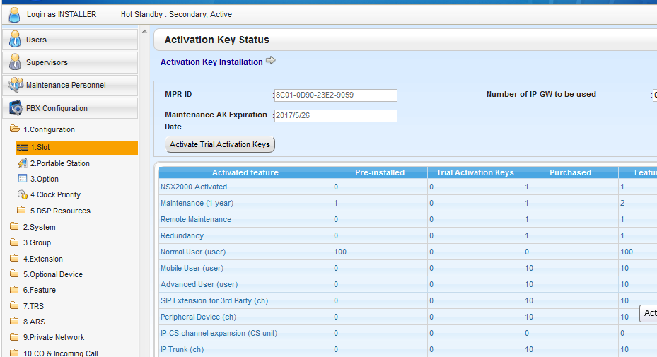
2. How it work?
V2
1+1 redundancy
All Aks that copied visible at Secondary NSX.

Slide 15
2. How it work?
V2
1+1 redundancy
Item | Basic feature support
Switching Condition | Auto + Manual
Switch back Condition | Manual
Data Transfer | Refer following Slide about detail
Target data to transfer | Most of system data except data stick with unit(ie IP address etc)
P2P call kept | NT55X/NT511/NT54X/NT560 - NT55X/NT511/NT54X/NT560
Call via DSP kept | -
Secondary server AK | 1)System AK, 2)Maintenance AK/[Mandatory] 3)Remote Maintenance AK [Op]
APL server | Automatic switch (Status initialize)
Notes:
ExpGW Reboot and call
Disconnect.
Cable for LAN3 connection
is OK with regular RJ45 cable.
LAN1/2 for regular LAN connection
LAN3 for Data transfer
P2P call kept is not available HDV/TGP
FWD On/Off setting can be BackUp

Slide 16
2. How it work?
V2
1+1 redundancy
P2P call kept is available only for the internal call between NT55x/511s/54X/560.
 | NT55x (*1) NT511 (*2) NT54x, NT560(*3) | NT3xx | HDV series, TGP600 | 3rd Party SIP Phone | DPT, APT, SLT | DECT PS | Soft-phone
NT55x (*1), NT511 (*2) NT54x, NT560(*3) | OK | NA | NA | NA | NA | NA | NA
NT3xx | NA | NA | NA | NA | NA | NA | NA
HDV series TGP600 | NA | NA | NA | NA | NA | NA | NA
3rd Party SIP Phone | NA | NA | NA | NA | NA | NA | NA
DPT, APT, SLT | NA | NA | NA | NA | NA | NA | NA
DECT PS | NA | NA | NA | NA | NA | NA | NA
Soft-phone | NA | NA | NA | NA | NA | NA | NA
Note) *1 : It is necessary to update firmware to V02.000.005 or later.
*2 : It is necessary to update firmware to V02.000.003 or later.

Slide 17
2. How it work?
V2
1+1 redundancy
P2P call kept is available only for the internal call between NT55x/511s/54X/560.

Slide 18
2. How it work?
V2
1+1 redundancy -Data transfer flow-
While Secondary Active
Data Transfer Flow
While Primary Active
LAN 3 IP address/Fixed
Primary :222.0.0.1
Secondary :222.0.0.2
-Normal operation condition, means Primary as Active unit and Secondary as Stand-by unit then Data transfer deployed from Primary to Secondary. The data can be transferred even Secondary become Active Unit.
-Primary unit connection to Secondary has to resume within 30days after Primary failure, otherwise Secondary unit
will be stopped.
-While Secondary Unit become active unit then it can continue to work after Primary unit re-connecting
to the network.

Slide 19
2. How it work?
V2
1+1 redundancy -Transferring Data-
Data type | Transfer timing
System configuration data | Periodic System data save Data change and save or log out from Web MC
UM prompt | Store/delete data
UM stored message | Store/delete message
OGM、MOH/BGM recorded data | Store/delete data
SMDR | While EXT terminate call
Call log | System data save
Data for hotel feature | Store/delete data
ACD report data | Create Report
Data Transfer start after completing process mention above.
The Max bandwidth over LAN 3 connection would be 36.9Mbps.

Slide 20
2. How it work?
V2
1+1 redundancy -Condition-
NSX Region code and
SSD size has to be exactly matched.
Otherwise doesn’t work.
- Data synchronization only for 2 units redundancy structure.
- Primary unit and Secondary unit need to be connected to same L2SW that support Gratuitous ARP.
- Firmware on both unit has to be exactly same.
- Data transfer is automatically conducted. It is possible to suspend data transfer by setting from Web-MC. Also
resume transfer as well.
- There is Active unit and Stand-by unit. Installer or Admin or user can make setting change while one of them
work as Active unit.
- If there is some issue present and data transfer process is suspended then this situation kept as error into error log
and suspending data transfer.
- There is no guarantee about matching system data in between two units so it is necessary to re-start data transfer
process by manual when Stand-By Unit become Active unit.
Logically Media Converter can be used as range extender for Log distance Pri-Sec installation. But we have never tested so far.

Slide 21
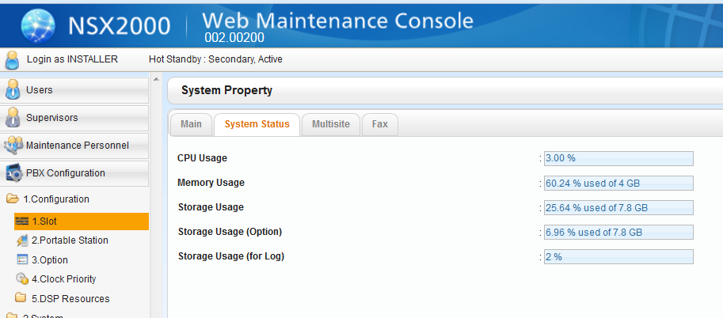
2. How it work?
V2
1+1 redundancy -Condition-
You can check SSD size for UM at this screen.

Slide 22
2. How it work?
V2
1+1 redundancy -Condition-
- Phenomenon during switch over from Active unit to Standby Unit.
Item | Phenomenon | Remarks
Call Process | All Call process restart except device under P2P conversation. | P2P Call at NT55 kept
WEB-MC | Web Session terminate. It is necessary to log in again.
CTI Interface | CSTA Session terminate. Application server need to re-build session with NSX again
IP Device direct connect to NSX | It is necessary to re-connect to NSX.
MRG IP Device | It is necessary to re-connect to NSX.
IP-CS direct connect to NSX | It is necessary to re-connect to NSX.
IP Trunk direct connect to NSX | It is necessary to re-connect to SIP server.
Trunk Adopter | It is necessary to re-connect..
NSX Expansion Box/Expansion GW | It is necessary to re-connect to NSX. Which means it has to be rebooted. All device under Expansion Box has to restart.

Slide 23
2. How it work?
V2
1+1 redundancy -Log-
Minor Error | Remarks | LOG/Syslog /Trap/Email
Operation Mode Changed: Hot Standby Down Timer Time Out (Keep Alive Time out) | Keep Alive Packet lost | ○
Operation Mode Changed: Hot Standby Recovery Timer Time Out | During start up No other Unit detect within Recovery Timer | ○
Data Transfer Incomplete | Data transfer stop in the middle of process and not possible to restart process | ○
Data Transmission Stopped | Data transfer stop in the middle of process | ○
Information | Remarks | LOG/Syslog /Trap/Email
Hot Standby: Primary started. | When Primary become Active Unit | ○
Hot Standby: Secondary started | When Secondary become Active Unit | ○

Slide 24
2. How it work?
V2
1+1 redundancy -LED, Packet/Port-
Data transfer speed approx. 51M/min.
Dsys+OGM approx. 80M
 | SYSTEM MODE LED |  | at Home screen of WEB-MC
 | Active System | Standby System | Active System | Standby System
Waiting for Data Sync （No initial Data Sync yet） | Green Slow Flash （G60INT） | Amber Lit | Suspended | Available (Receiver)
Waiting for Data Sync | Green Lit | Amber Lit | Available (Sender) | Available (Receiver)
Data Sync in progress | Green Fast Flash（G120INT） | Amber Lit | Executing | Available (Receiver)
While Active NSX show “Waiting for Data Sync（No initial Data Sync yet）” state
then it is necessary to initiate “Data Transfer Start” to make data sync.

Slide 25
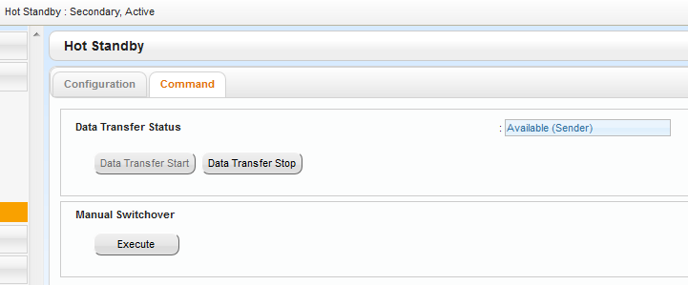
2. How it work?
V2
1+1 redundancy -LED, Packet/Port-
Above example show “Waiting for Data Sync” status.

Slide 26
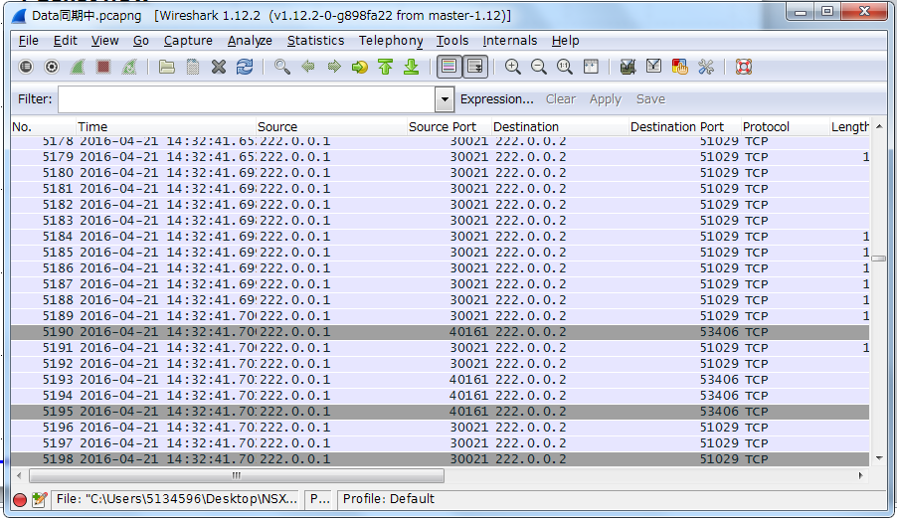
1-3. Key Features
V2
1+1 redundancy –Packet flow-
LAN 3 IP address/Fixed
Primary :222.0.0.1
Secondary :222.0.0.2

Slide 27
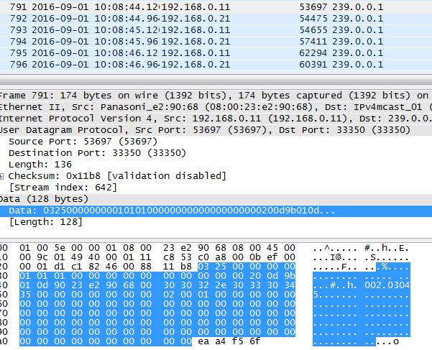
1-3. Key Features
1+1 redundancy –Packet flow-
IGMP
Keep Alive packet between Primary unit and Secondary unit exchange by Multicast packet.
Thus if L2SW use for NSX connection is managed switch and has IGMP feature then it is necessary to check network environment.
If there is IGMP Querier then it is OK to be set enable IGMP feature at switch . If there is no IGMP Querier then it must be disable at switch.
Otherwise NSX will lose physical connection to switch thus switch close the port.

Slide 28
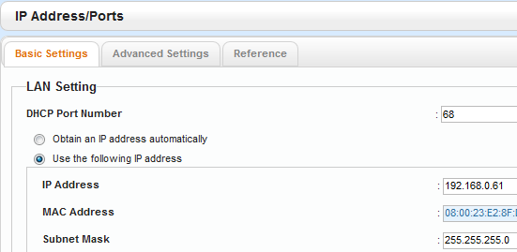
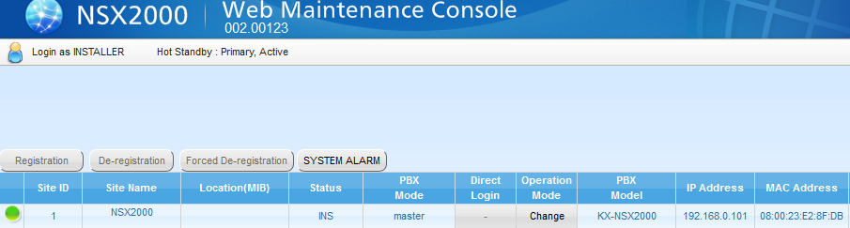
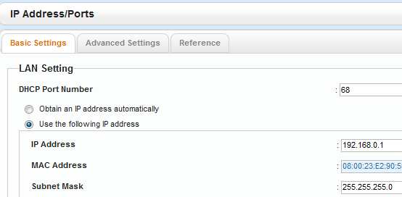
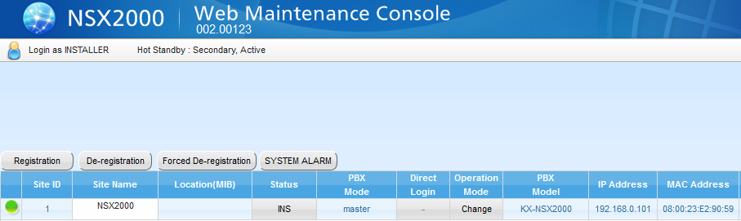
1-3. Key Features
V2
1+1 redundancy -IP Address-
Actual IP Address
Virtual IP Address

Slide 29
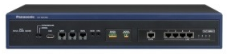

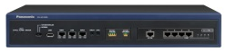


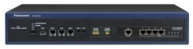

ection Diagram
2. How it work?
V2
KX-NSX1000
KX-NSX2000
Case-1
Primary Unit
Secondary Unit
A)“System Mode LED” of Active Machine
Green lit :
NT phone can be ready to
start registration process.
B) “Status LED” of Active Machine Lit
All service from Active Machine ready to serve
Between A) and B) UM and Web Access is not ready.
ExpGW start up process is started before A).
Case-2
Exp-GW (Expansion gateways)
KX-NS1000
KX-NS300/500/700
NS320/520/720
Legacy Gateway
(KX-TDE600/620,
KX-TDA600/620/100D)

Slide 30
ection Diagram
2. How it work?
V2
KX-NSX1000
KX-NSX2000
Active Unit
Stndby Unit
In case sudden absence of Active Unit
A)Power down
There will be 30-60sec*1 service hold time until Standby Unit become Active.
Power down unit come back to network and other Active unit presence can be detect through LAN1/2
then this unit become Standby state.
B)LAN1/2 Cable disconnection, LAN3 connection present
There will be 30-60sec*1 service hold time until Standby Unit become Active.
Reconnect LAN1/2 then immidiately original Active unit be a Active unit and other unit back into Standby state.
The Status LED at Active unit slow blink which means data sync necessary.
*1:No SSD for UM then approx 30sec/ SSD for UM installed then approx 60sec

Slide 31
2. How it work?
V2
System Behavior at switch over *Time may vary.
 |  | NSX Redundancy (Switch between Primary and Secondary) |  | Simplified Isolated Mode (Switch between NSX and EXP-GW)
 |  | Primary->Secondary | Secondary->Primary | Normal->Isolated | Isolated->Normal
Call Connection | P2P | Keep | Keep | Keep | Keep
 | Non P2P | Disconnect | Disconnect | Disconnect | Disconnect
NSX Unit and the Terminals | Unit | Standby NSX-application level Reboot | Standby NSX-application level Reboot | - | -
 | Terminal | Application level Reboot and Re-connection to Secondary | Application level Reboot and Re-connection to Primary | Reboot 6 minutes* until Started up | Reboot 6 minutes* until Started up
EXP-GW Unit and The terminals | Unit | Reboot | Reboot | Reboot 6 minutes* until Started up | Reboot 6 minutes* until Started up
 | Terminal | Reboot 6 minutes* until started up | Reboot 6 minutes* until started up | Reboot 6 minutes* until Started up | Reboot 6 minutes* until Started up
CTI server (connected to Primary) |  | Application Restart (CTI link re-connection) | Application Restart (CTI link re-connection) | No service | No Service

Slide 32
2. How it work?
Survival gateway feature (Simplified Isolated mode)
Expansion gateway will be in “Simplified Isolated Mode” in case of,
NSX Master can’t be detected during starting up or running as Expansion GW
Manually switch to “Simplified Isolated Mode”
There is basic operation only such as outgoing and incoming call during this mode.
“Simplified Isolated Mode” can be continued for 30 days.
The mode is expired after 30 days. When 30 days passed all services are stopped until switching back to normal mode.
“Simplified Isolated Mode” can be released either manual operation, scheduled or automatic.
ExpGW1
“Simplified Isolated Mode”
Required AK:
KX-NSXF006 Expansion GW (Master)
Required AK:
KX-NSXF007 Expansion GW(Slave)

Slide 33
2. How it work?
Survival gateway feature (Simplified Isolated mode) -Condition-
<Activation keys>
No additional Activation key is required to use “Simplified Isolated Mode” on top of
KX-NSXF007 Expansion GW(Slave).
<Programming>
To setup NS series PBX as Simplified Isolated Mode, it is required to program individually them
beforehand.
Otherwise “Simplified Isolated Mode” will not be functioned.
For example, IPPhone need to register at both Normal mode(connect to NSX) and Simplified Isolated
Mode.
There are 2 ways to program.as follows.
1. Online Programming
Put an expansion GW to Simplified Isolated Mode manually, then program it using WEB Maintenance console of NS. After completing the programming, put it back to normal mode.
2. Offline Programming
Create DxSYS file of NS by using offline tool of NS system, them upload the DxSYS file into Expansion GW.
Dsys format has to be V4.2 format

Slide 34
2. How it work?
Survival gateway feature (Simplified Isolated mode) -Condition-
<Limitation of Simplified Isolated Mode operation>
During “Simplified Isolated Mode “ works according to the configuration setting for the mode. The level of supported features is NS series ver.4.2, The new feature from NSX series, such as Smart Desk, LDAP directory service and so on, are not supported.
And some of features are restricted in the mode and the restricted features are as follows.
Un available feature | Description/Conditions | Notes
Built-in UM (including Auto 2-way recording, 2-way recording, FAX) | UM on an expansion GW is not available.
CTI Interface(3rd party CSTA) | 3rd Party CTI Interface is not available
Built-in ACD monitor/report | No ACD monitor / report is available
- Number of available resources (such as extensions, trunks, DSP etc.) depends on each NS model.
- System logging data (such as SMDR, Call Log etc.) is not merged into NSX call server when
the system back to normal mode as well as NS system.
- NSX system shows the status of running mode by flexible button on specified PT.
- When one-look mode changes to Simplified Isolated mode, system reboot occurs.
Notes:
OGM necessary to install
cabinet by cabinet

Slide 35
2. How it work?
Survival gateway feature (Simplified Isolated mode) -Condition-
Model | Feature Description | Remarks
KX-NSM099 | IP Capacity EXP(640EXT) | NS1000 only
KX-NSM102/108/116 | IP Trunk AK
KX-NSM201/205/210/220 | IP Softphone, IP Terminal
KX-NSM501/505/510/520 | IP terminal
KX-NSM701/705/710/720 | 3rd Party SIP terminal
KX-NSE201/205/210/220 | IP-CS channel expansion
KX-NSF990 | For VoIP | NS300 only / only for IP, not for UM
KX-NSF991 | Expansion AK | NS700 only
KX-NSN101 | Built In Router | NS1000 only
Above Activation key will be automatically deployed to Gateway. Feature related AK other than above AK will not work even AK installed to system before.
Trunk and EXT can be used up to maximum capacity while working as “Simplified Isolated Mode”.

Slide 36







2. How it work?
V2
Multiple LAN network support for SIP GW
NAT Traversal Table
Name / Fixed Address
1: Alpha 10.28.4.78
2: Bravo 10.28.4.79
3: Charlie 10.28.4.80
4: Delta 10.11.8.14
5: Echo 10.11.8.15
6: Foxtrot 11.23.8.22
7: Oscar 11.24.5.62
8: Zulu 10.28.4.79
NSX Local Network
111.168.5.0
NAT-A
Global IP: 10.28.4.78
Local: 111.168.3.0
SIP Server
Alpha
10.11.2.39
L3 Switch
NAT-B
Global IP: 10.28.4.79
Local: 111.168.4.0
SIP Server
Zulu
10.15.2.44

Slide 37
2. How it work?
V2
Multiple LAN network support for SIP GW
1: INVITE for Zulu Subscriber
8: Zulu Fixed Global IP address
10.28.4.79
DST: 10.15.2.44
SRC: 111.168.5.114
IN IP4: 111.168.5.114
2: Refer NAT Traversal setting Table No set at Basic Ch.
Define Global IP need to be used for INVITE
Which is 10.28.4.79 in this sample.
NSX Local Network
111.168.5.0
NAT-A
Global IP: 10.28.4.78
Local: 111.168.3.0
SIP Server
Alpha
10.11.2.39
DST: 10.15.2.44
SRC: 10.28.4.79
IN IP4: 10.28.4.79
DST: 10.15.2.44
SRC: 111.168.5.114
IN IP4: 10.28.4.79
L3 Switch
3: Set 10.28.4.79 as Media part IP to SDP message.
NAT-B
Global IP: 10.28.4.79
Local: 111.168.4.0
SIP Server
Zulu
10.15.2.44
4: NAT-B SRC IP rewrite

Slide 38
2. How it work?
V2
Multiple LAN network support for SIP GW
7: Subscriber's IP address
received
NAT-A
Global IP: 10.28.4.78
Local: 111.168.3.0
DST: 111.168.5.114
SRC: 10.15.2.44
IN IP4: 10.15.2.44
NSX Local Network
111.168.5.0
SIP Server
Alpha
10.11.2.39
5: Reply [200 OK] (divert SRC,DST )
Media part has subscriber IP
DST: 10.28.4.79
SRC: 10.15.2.44
IN IP4: 10.15.2.44
L3 Switch
DST: 111.168.5.114
SRC: 10.15.2.44
IN IP4: 10.15.2.44
NAT-B
Global IP: 10.28.4.79
Local: 111.168.4.0
SIP Server
Zulu
10.15.2.44
6: NAT-B rewrite DST

Slide 39
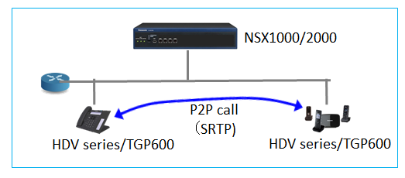
2. How it work?
V2
SRTP supported at internal call
SRTP (Secure Real time Transport Protocol) is supported at internal calls on NSX1000/2000. Following table shows supported type of call and devices for SRTP communication.
Type of call | Only P2P call
Supported device | KX-HDV series (*1) and KX-TGP600
*1: HDV100/130 don’t support this feature.
HDV and TGP600 need to up grade firmware to support this feature.
Supported firmware may release at same time as NSX V2.

Slide 40
2. How it work?
V2
SRTP supported at internal call
Condition
Supported Terminal : KX-HDV230, KX-HDV330, KX-HDV430, TGP600
-It is necessary to up date firmware with applicable firmware.
V2.2XX(version name may vary)
-It is necessary to change setting at KX-HDV230/330/430, TGP600 with configuration file down load
by using DHCP option66.
-These setting has to be matched at all of KX-HDV230/330/430, TGP600 under same system.
- KX-HDV230/330/TGP600
SRTP_CONNECT_MODE_n=2 (n=line No. 1:default, 0:no use for PBX connection)
SRTP_MIX_TRANSFER_ENABLE_n=Y (n=line No. N:default)
- KX-HDV100/130：
SRTP_MIX_TRANSFER_ENABLE_n=Y (n=line No. N:default)
-SRTP applicable for P2P call between supported device such as KX-HDV230/330/430 and
KX-TGP600.
-There is no SRTP on conversation like;
Conference call, P2P Call exit from Conference Call, Transferred Call, Hold Call retrieve at
other EXT.
For example , set for line 1;
SRTP_CONNECT_MODE_1=2

Slide 41
2. How it work?
V2
SRTP supported at internal call
Condition
- RTP call can’t be transferred to KX-HDV230, KX-HDV330 and TGP600 while they are SRTP
mode. The call will be recalled immediately.
This can be adjusted by setting at NSX side
Transffering RTP held call to SRTP support terminal has restriction
It can be change behavior by Sales Company Op-bits 18-1
Mode1: In case held call is RTP then not inform SRTP ability
Mode2: Always inform SRTP ability even there is RTP held call. The call be recall immediately.
When not using SRTP
- It is not necessary to change firmware/config.
- It is necessary to keep setting for KX-HDV100/130/230/330/TGP600 as bellow(default)
> > SRTP_CONNECT_MODE_n=1 (n=line No., 1/Default)
> > SRTP_MIX_TRNASFER_ENABLE_n=N (n=line No., N/Default)
*We are studying to show type of call SRTP/RTP indication at LCD of HDV and eliminate
some of condition by V2.03XXX.

Slide 42
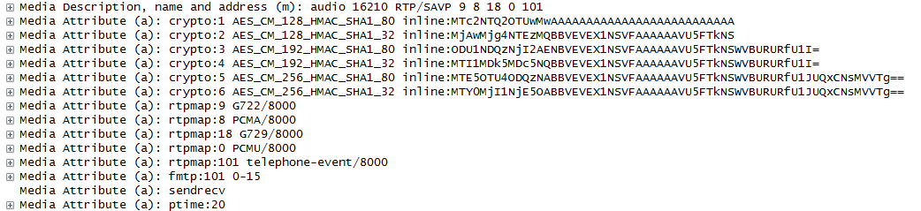
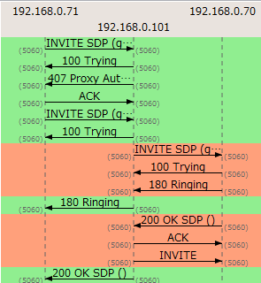

2. How it work?
V2
SRTP supported at internal call
To confirm whether voice packet be a SRTP or not;
1)Checking “INVITE” SDP from caller
IP:192.168.0.101
IP:192.168.0.71
IP:192.168.0.70
m line contain RTP/SVAP
Media Attribute show crypto
2)Checking “200 OK” SDP from callder
m line contain RTP/SVAP
Media Attribute show crypto

Slide 43
Chapter 3
How to program?

Slide 44
3. How to program? - The procedure to create Multi-Connection
1. To change NS1000/700/500/300 to Expansion gateway.
1-1. Update the firmware of NS1000/700/500/300 to Ver.4.3xxxxx.
If migrate with NSX system from current NS system, export the DxSYS file.
1-2. Update the firmware from Ver4.3xxxxx to the firmware of Expansion GW
(PCEXPGW_001_xxx_xxx for NS1000, PFEXPGW_001_xxx_xxx for NS700/500/300).
⬅At this point NS come up as Simplified Isolated Mode and show original NS’s MPR-ID.
1-3. Initialize and Easy Setup the Expansion GW.
The MPRID of NS will be changed for ExpGW after initialization.
It is necessary to get the AK (KX-NSXF007) for expansion gateway (Slave)
by new MPRID.
2. Create Multi-Connection.
2-1. Install AK (KX-NSXF006) for expansion gateway (Master) to NSX.
2-2. Add Site
2-3. Registration

Slide 45
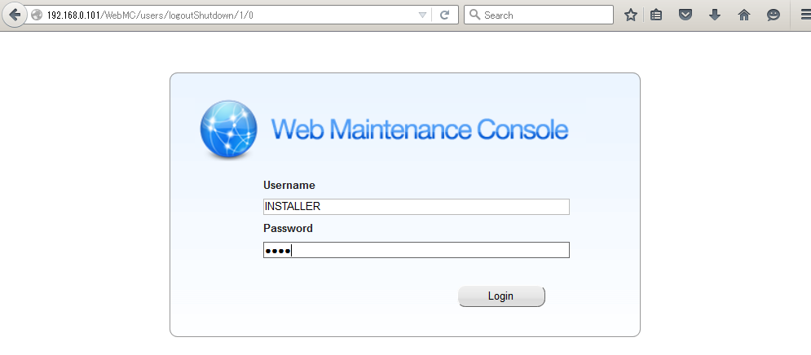
3. How to program? - The procedure to create Multi-Connection
1-3. Initialize and Easy Setup the Expansion GW
Login to the Expansion GW after initialize.
Default value,
IP address : 192.168.0.101
Username : INSTALLER
Password : 1234

Slide 46
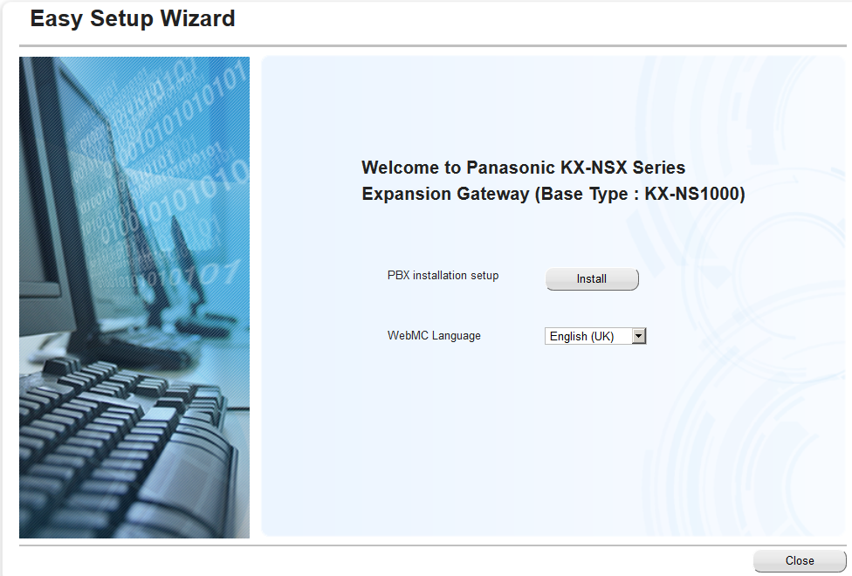
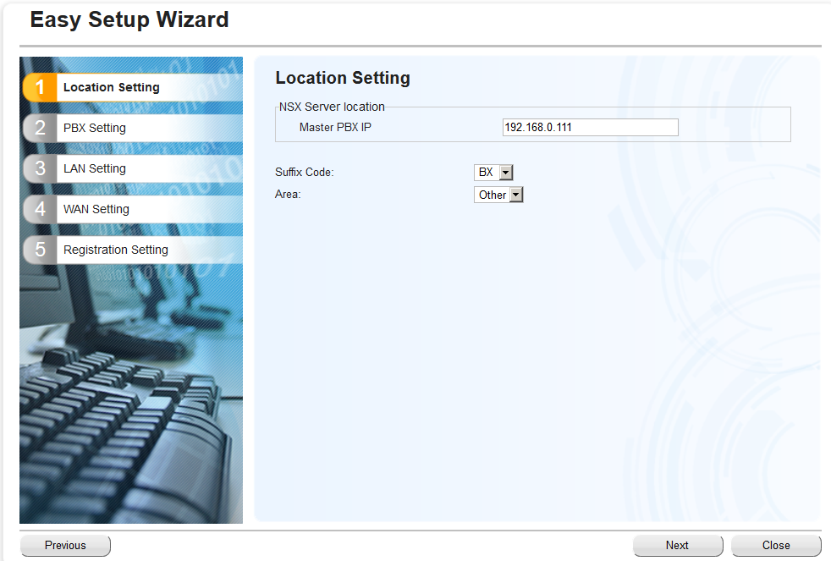
3. How to program? - The procedure to create Multi-Connection
1-3. Initialize and Easy Setup the Expansion GW
Select WebMC Language,
then click “Install”.
Enter IP address of NSX,
then click “Next”.

Slide 47
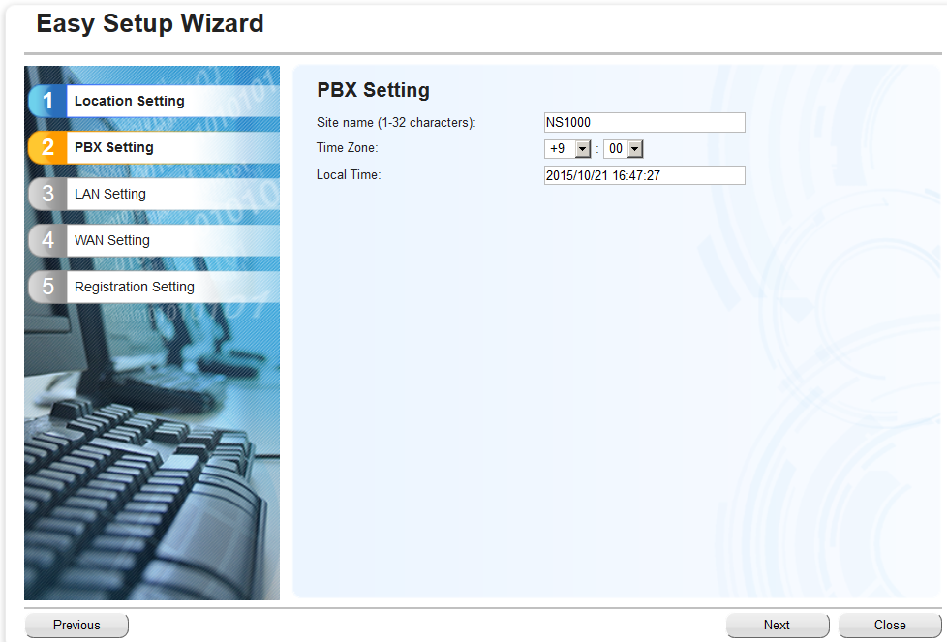
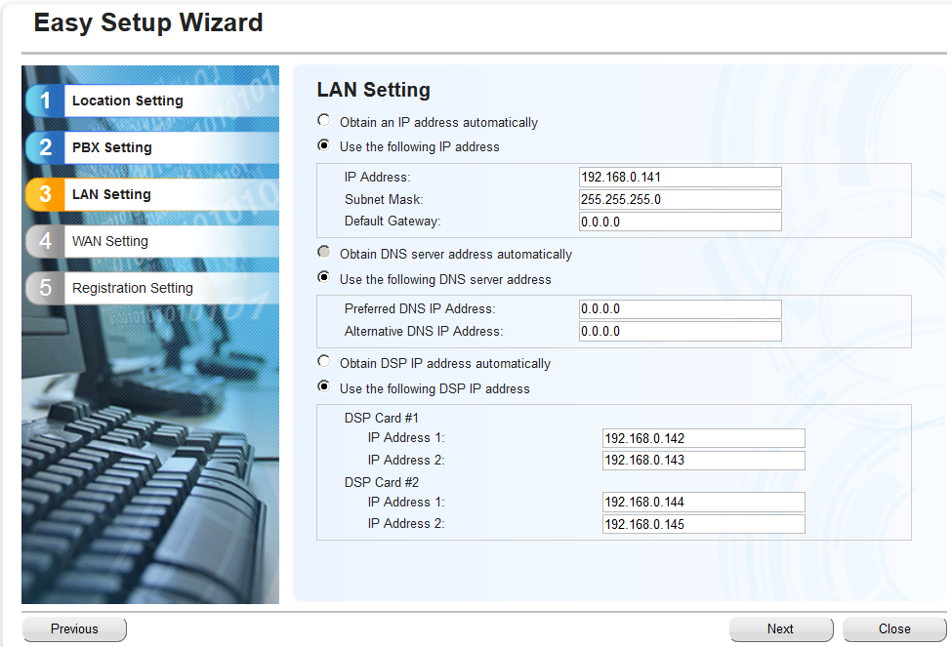
3. How to program? - The procedure to create Multi-Connection
1-3. Initialize and Easy Setup the Expansion GW
Click “Next”.
Enter IP address of Expansion GW,
then click “Next”.

Slide 48
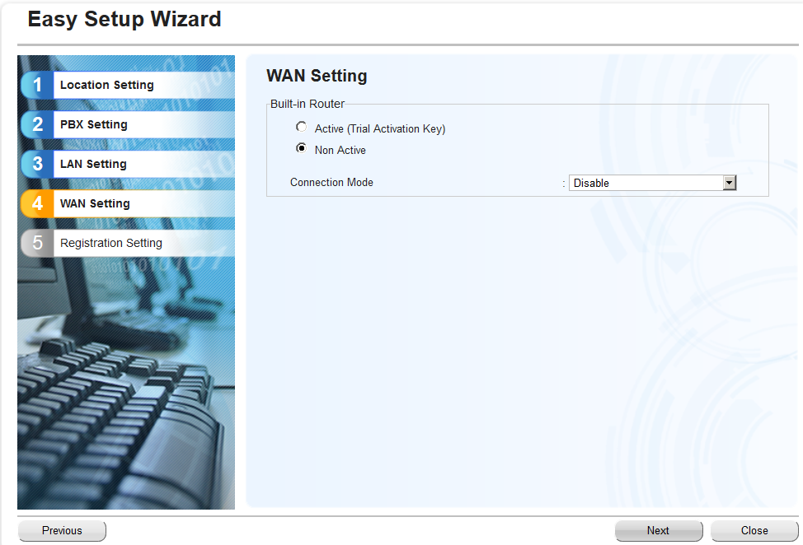
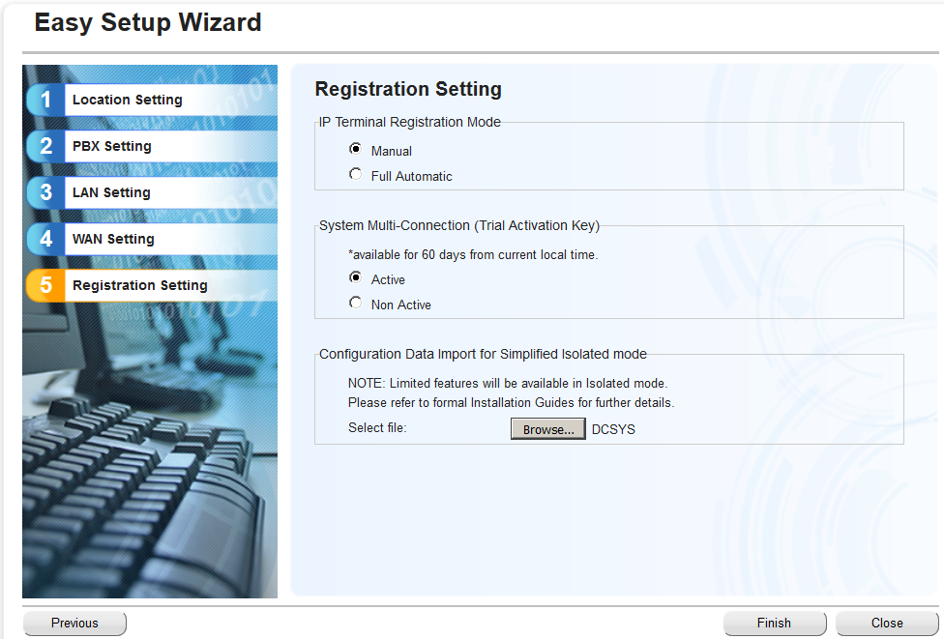
3. How to program? - The procedure to create Multi-Connection
1-3. Initialize and Easy Setup the Expansion GW
If migrate with NSX system from current NS system,
import the DxSYS file from here.
Click “Next”.
Select Active for System Multi-Connection
(Trial Activation Key), then click “Finish”.

Slide 49
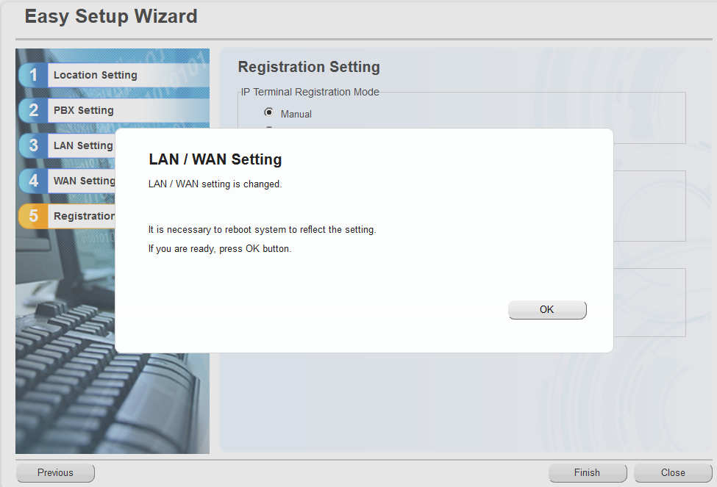
3. How to program? - The procedure to create Multi-Connection
1-3. Initialize and Easy Setup the Expansion GW
NS becomes Expansion Gateway.
If change LAN / WAN Setting this screen will be shown,
then click “OK”.

Slide 50
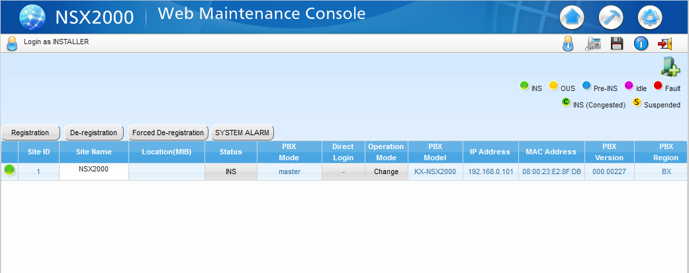
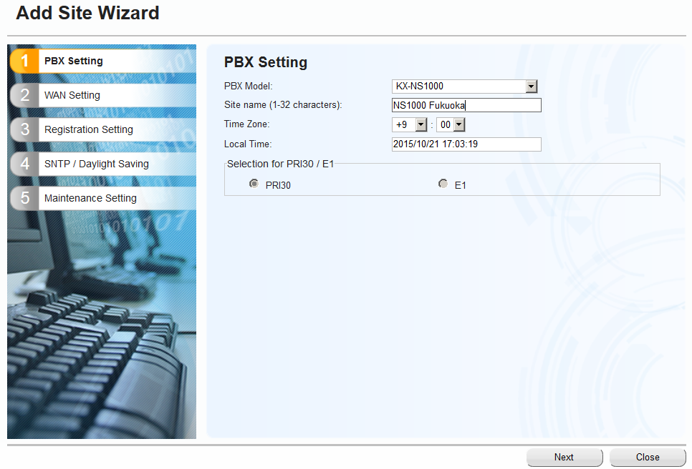

3. How to program? - The procedure to create Multi-Connection
2-2. Add Site
Login to NSX.
Click “ “, Select PBX Model, then click “Install”.

Slide 51
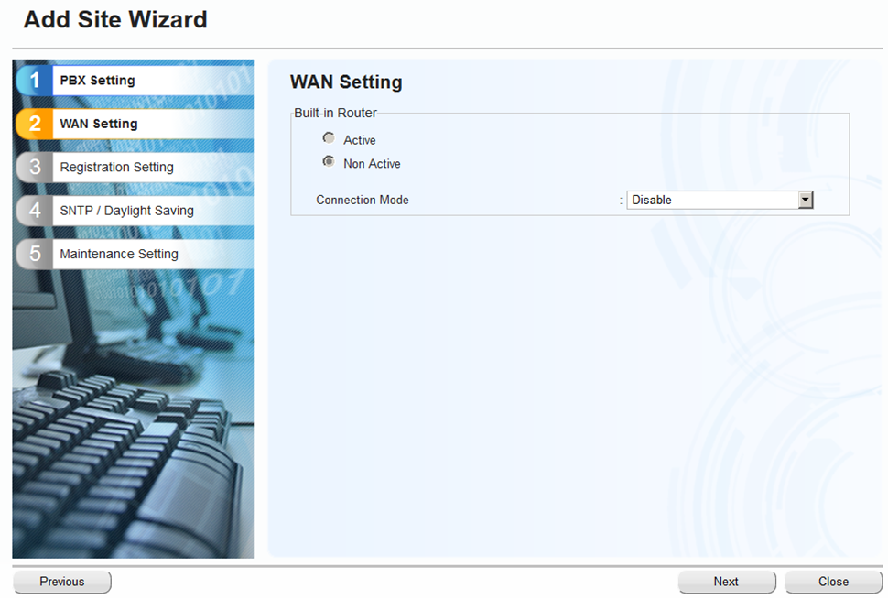
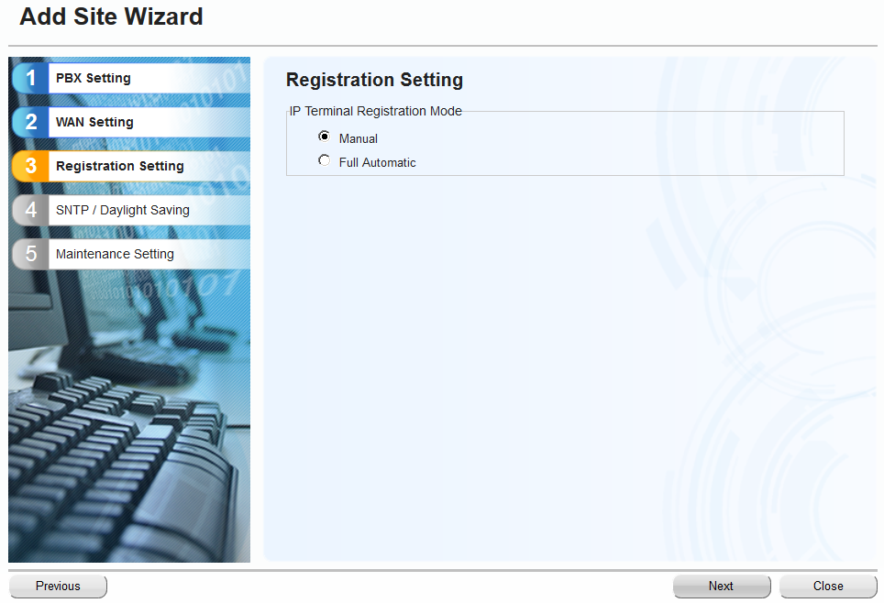
3. How to program? - The procedure to create Multi-Connection
2-2. Add Site
Click “Next”.
Click “Next”.

Slide 52
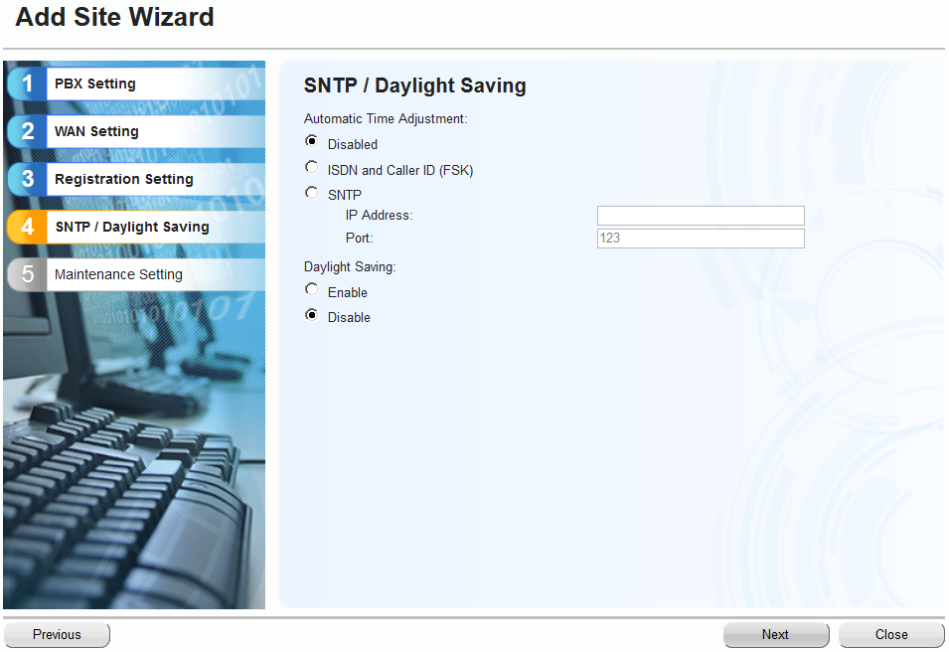
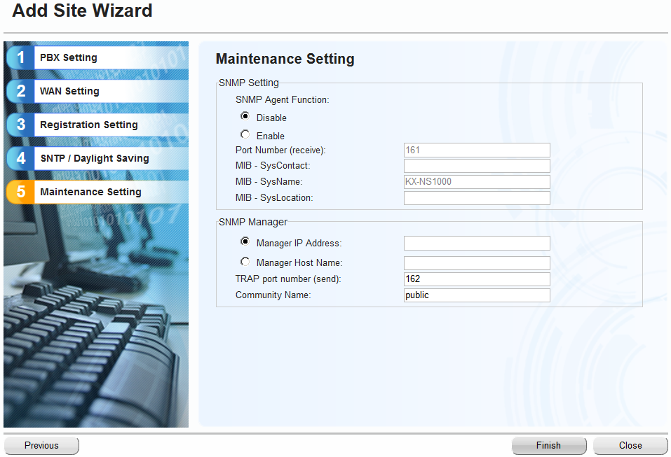
3. How to program? - The procedure to create Multi-Connection
2-2. Add Site
Click “Next”.
Click “Finish”.

Slide 53
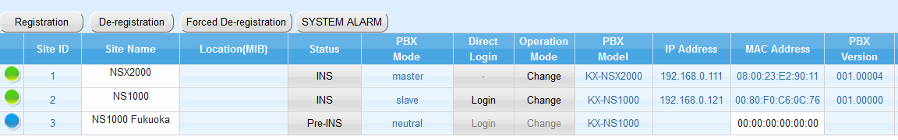
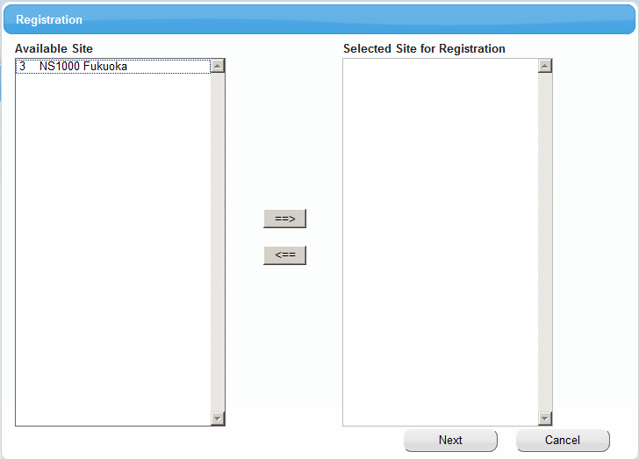
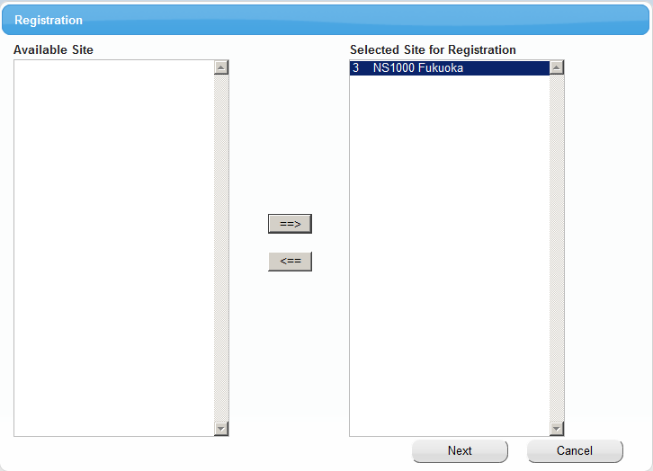
3. How to program? - The procedure to create Multi-Connection
2-3. Registration

Slide 54
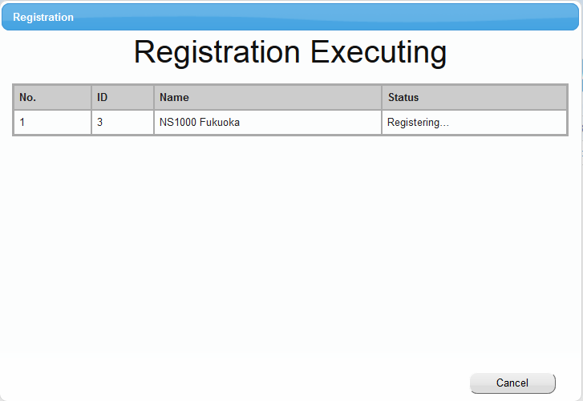
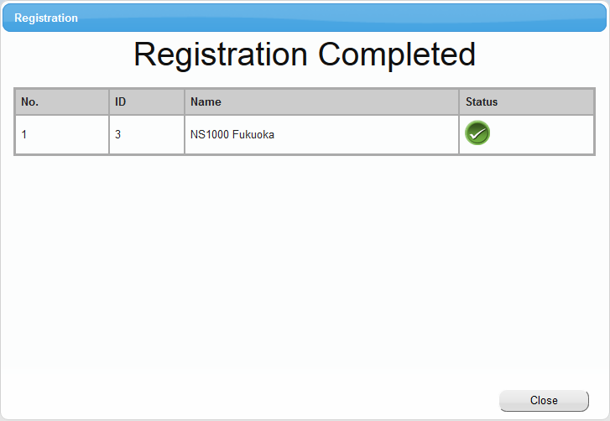
3. How to program? - The procedure to create Multi-Connection
2-3. Registration
Expansion Gateway will restart.

Slide 55
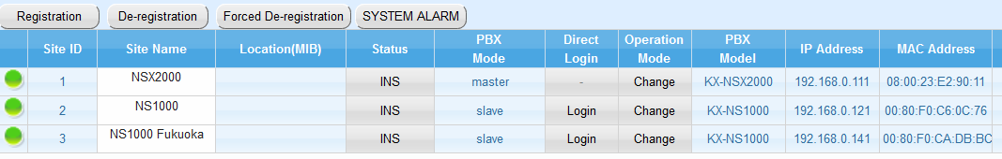
3. How to program? - The procedure to create Multi-Connection
2-3. Registration
Registration Complete.
It should install the AK (KX-NSXF007)* for expansion gateway (Slave) to Expansion GW
before expire the trial period.
*Expansion box doesn’t require this AK.

Slide 56
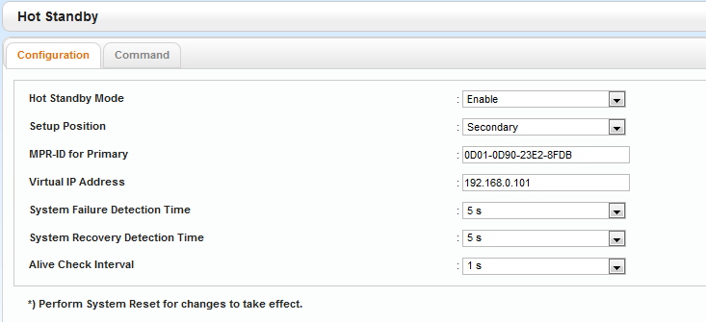
3. How to program -1+1 Redundancy-
1+1 redundancy
Maintenance-System Control-6.Hot Standby
-Feature Enable/Disable
-Primary/Secondary
-Other side NSX’s MPR-ID
-Virtual IP
-Down detection timer
-Up detection timer
-KA interval
can be set here.

Slide 57
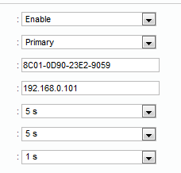
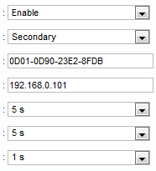
3. How to program -1+1 Redundancy-
1+1 redundancy
Maintenance-System Control-6.Hot Standby
At Primary Unit
At Secondary Unit
Virtual IP Address
This address need to
set at NT phone as
PBX IP address.
It is necessary to conduct System reset to effect these setting for the unit.

Slide 58

3. How to program -1+1 Redundancy-
1+1 redundancy
Maintenance-System Control-6.Hot Standby
1) “System Failure Detection Time”
Timer to confirm other system non-presence. If there is no Keep alive packet more than
this time period then Standby Machine proceed to change to Active Machine.
2) “System Recovery Detection Time”
Timer to confirm other system presence. If there is Keep alive packet presence
more than this time period just after start up then Former Standby Machine proceed to change to
Standby Machine. And Former Active machine keep running as Active Machine.
“Alive Check Interval”
Keep Alive Packet Sending interval.

Slide 59


3. How to program -1+1 Redundancy-
1+1 redundancy -Setup Flow-
Sample scenario
Add Secondary to Live NSX
At Primary Unit
Back up Dsys
Change Actual IP address for the unit.
Install Hot standby feature AK
Set Hot standby feature “Enable”
Select as Primary Unit
Set Secondary Unit MPR-ID
Set Virtual IP Address of NSX
Reboot Unit to take effect of above settings
At Secondary Unit
Conduct Easy Set Up Wizard
Transfer Dsys that is backed up from Primary Unit
Change Actual IP address for the unit.
Set Hot standby feature “Enable”
Select as Secondary Unit
Set Primary Unit MPR-ID
Set Virtual IP Address of NSX
Reboot Unit to take effect of above settings
It is necessary to push “Data Transfer Start” button
at “Hot Standby-Command” screen.
1)Running by single cabinet
Actual IP Addr : 192.168.0.101
MPRID : 0D01-0D90-23E2-8FDB
PBX IP Addr.: 192.168.0.101
2)Add second cabinet for 1+1 Redundancy
Primary Unit
Actual IP Addr.: 192.168.0.61
Virtual IP Addr.: 192.168.0.101
MPRID : 0D01-0D90-23E2-8FDB
Secondary Unit
Actual IP Addr.: 192.168.0.1
Virtual IP Addr.: 192.168.0.101
MPRID : 8C01-0D90-23E2-9059
PBX IP Addr.: 192.168.0.101
PBX IP Addr.: 192.168.0.101
*It is better to set original PBX IP Addr.: 192.168.0.101 as virtual and change actual
IP address to Primary unit. It is easiest way to deploy 1+1 redundancy.
Thus it is not necessary to change PBX IP address at phone side.
Unnecessary to change also, such as those of the following (OK in the access to the virtual IP).
- Master IP of ExpGW, CTI Server connection PBX IP, IPCS, etc

Slide 60
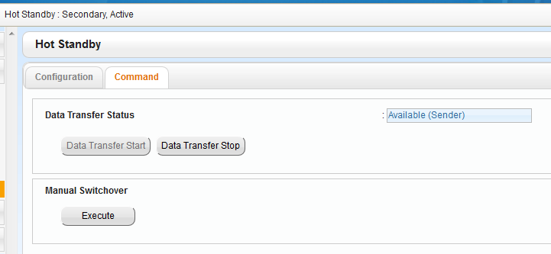
3. How to program -1+1 Redundancy-
1+1 redundancy
Maintenance-System Control-6.Hot Standby
After initial data sync has been finished then
you would see “Available(Sender)” at Active NSX.

Slide 61
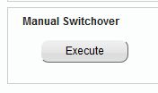
3. How to program -1+1 Redundancy-
1+1 redundancy
Maintenance-System Control-6.Hot Standby
When you need to switch Active NSX to Standby.
Firstly access NSX by virtual IP and save system data by
pushing Floppy icon before you “Execute” manual switchover to avoid losing setting data as much as possible.

Slide 62
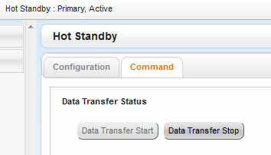

3. How to program -1+1 Redundancy-
1+1 redundancy -Firmware Update-
Up load new firmware to Active NSX and Standby NSX separately
Stop data transfer by pushing “Data Transfer Stop” button at Active NSX.
Wait for “Suspend” appearance
Activate new firmware at Standby NSX
Activate new firmware at Active NSX
After both NSX start up then initiate data sync by pushing “Data Transfer Start” button.

Slide 63
3. How to program -1+1 Redundancy-
1+1 redundancy
-While manual switchover, there is no service period about 30sec.
- PT-PRG/ FWD setting / Service In/Out etc non-WebMC base setting changes not copy to
standby NSX besides pushing floppy icon. Or twice in a day/default( it can increase up
to 6 times in a day.

Slide 64
3. How to program -1+1 Redundancy-
1+1 redundancy -Firmware Update-
Up load new firmware to Active NSX and Standby NSX separately
Stop data transfer by pushing “Data Transfer Stop” button at Active NSX.
Wait for “Suspend” appearance
Activate new firmware at Standby NSX
Activate new firmware at Active NSX
After both NSX start up then initiate data sync by pushing “Data Transfer Start” button.

Slide 65
3. How to program -1+1 Redundancy-
Default Value change
-Keep Alive for IPPT 20sec->60sec

Slide 66
3. How to program? - Simplified Isolated Mode
1. Simplified Isolated Mode Settings
2. Operation Mode Change to program for Simplified Isolated mode
3. Login to the target site to program
4. Back to Normal mode
Set “Isolated Mode” to “Enable”.

Slide 67
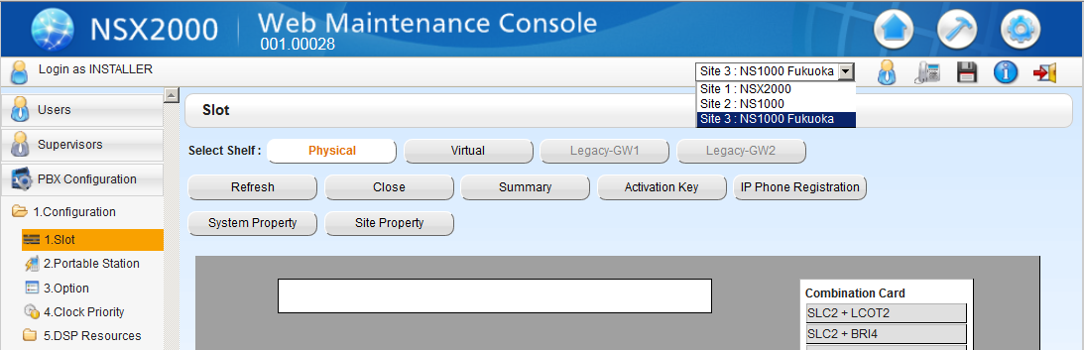

3. How to program? - Simplified Isolated Mode
1. Simplified Isolated Mode Settings
Change to target site and select “Main” in Site Property

Slide 68
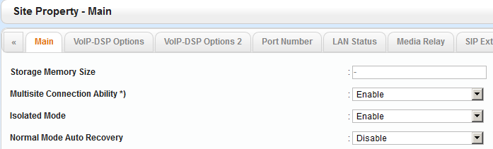
3. How to program? - Simplified Isolated Mode
1. Simplified Isolated Mode Settings
Set “Isolated Mode” to “Enable”
-Simplified Isolated Mode : Disable(Default) / Enable
-Automatic recovery from Isolated to Normal : Disable(Default) / Enable
Note) To program NS series in Simplified isolated Mode, the setting of “Normal Mode Auto Recovery” should be “Disable”.

Slide 69
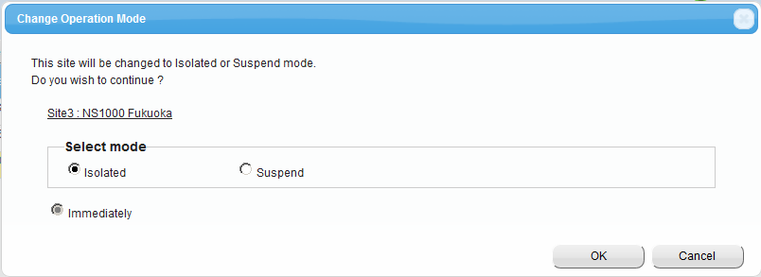
3. How to program? - Simplified Isolated Mode
2. Operation Mode Change to program for Simplified Isolated mode
Click “Change” of Operation Mode, select “Isolated”, then click “OK”.
The target site will restart and work as Simplified Isolated mode. You can program it by login directly.

Slide 70
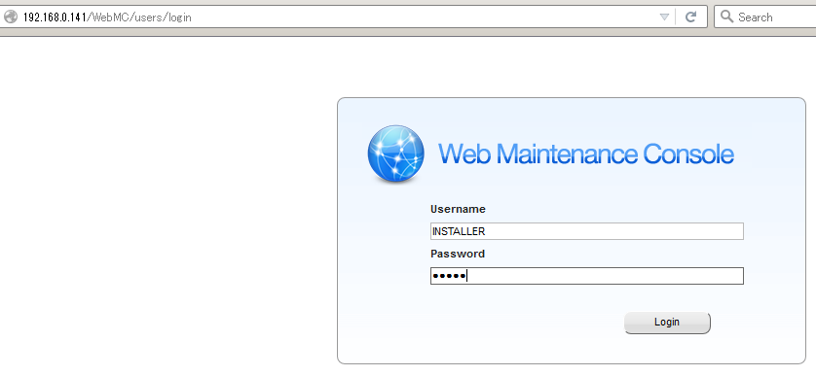
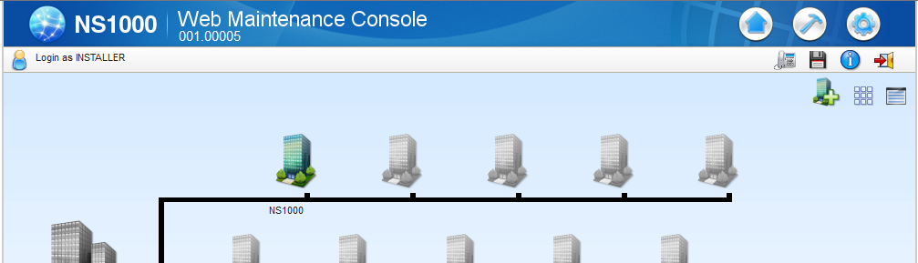
3. How to program? - Simplified Isolated Mode
3. Login to the target site to program
Enter “IP address of target site”, then login.

Slide 71


3. How to program? - Simplified Isolated Mode
4. Back to Normal mode
Click “Change” of Operation Mode, select “Immediately”, then click “OK”.
The target site will restart and work as normal mode.

Slide 72

3. How to program? -AK-
Activation Key for Redundancy
Redundancy
Notes:
The maximum number of physical interface cards which can be installed to the KX-NS1000 is shown here.

Slide 73


3. How to program -Multiple LAN Network for SIP Trunk-
Multiple LAN network support
NAT Traversal tables can be set at
PBX Configuration
-1.Configuration
-1.Slot
-Shelf Property-Virtual SIP Gateway
8 tables for NSX,
1 table for Expansion Box

Slide 74

3. How to program -Multiple LAN Network for SIP Trunk-
Multiple LAN network support
NAT Traversal tables No. need to be set for each Basic Ch at
PBX Configuration
-1.Configuration
-1.Slot
-PortProperty-Virtual SIP Gateway
8 tables for NSX,
1 table for Expansion Box/Expansion GW

Slide 75
3. How to program -SRTP on internal call-
HDV/TGP600 SRTP related setting
How to program HDV/TGP side?
It is necessary to set bellow by uploading config file.
- KX-HDV230/330/430, TGP600
SRTP_CONNECT_MODE_n=2 (1:default, n=line No. , 0:no use for PBX connection)
SRTP_MIX_TRANSFER_ENABLE_n=Y (N:default, n=line No. )
- KX-HDV100/130：
SRTP_MIX_TRANSFER_ENABLE_n=Y (N:default, n=line No. )
NSX side
Transffering RTP held call to SRTP support terminal has restriction
It can be change behavior by Sales Company Op-bits 18-1
Mode1: In case held call is RTP then not inform SRTP ability
Mode2: Always inform SRTP ability even there is RTP held call. The call be recall immidiately.

Slide 76


3. How to program –SIP-TLS for SIPEXT-
HDV/TGP600 SIP-TLS related setting *It is necessary to reboot after changing below parameter.
Need to set “Enable(SIP-TLS)
Using port 5061

Slide 77


3. How to program –SIP-TLS for SIPEXT-
HDV/TGP600 SIP-TLS related setting
When HDV connect to NSX/ExpGW then It is necessary to take out certification file from NSX/ExpGW and put into HDV.

Slide 78



3. How to program –SIP-TLS for SIPEXT-
HDV/TGP600 SIP-TLS related setting
Then, 1) put certification file into HDV, 2) change SIP port number to 5061, 3) change protocol to TLS at HDV side
and reboot HDV.
“Import Certification File” menu can be seen by high level ID access only.And high level ID can’t be disclosed to dealer due to security reason.

Slide 79




3. How to program –set by cfg file-
HDV/TGP600 SIP-SRTP/-TLS related setting
The certification file, necessary setting on config file need to be downloaded by DHCP option66.
Some of hidden parameter for “admin” right has to be set up by bellow method.
DHCP Discover
DCHP server
DHCP Offer
TFTP read request
TFTP server
Down load “KX-HDV430x.cfg”

Slide 80
3. How to program –set by cfg file-
HDV/TGP600 SIP-SRTP/-TLS related setting
The certification file, necessary setting on config file need to be downloaded by DHCP option66.
Some of hidden parameter for “admin” right has to be set up by bellow method.
SIP-TLS Command sample for KX-HDV***x.cfg
# PCC Standard Format File # DO NOT CHANGE THIS LINE!
SIP_TRANSPORT_1="2"
SIP_TLS_MODE_1="1"
SIP_RGSTR_PORT_1="5061"
SIP_PRXY_PORT_1="5061"
SIP_PRSNC_PORT_1="5061"
SIP_OUTPROXY_PORT_1="5061"
SIP_TLS_ROOT_CERT_PATH="tftp://192.168.0.210/Root_CERT.cfg"
- CFG file name format is “KX-HDV***x.cfg”
***=430 in case HDV430
- These example for “Line1”.
- Certification file name for NSX is “Root_CERT.cfg”
- Certification file name for ExpGW is “Root_CERT_EXPGW.cfg”
HDV430 need below command for SIP-TLS
SIP-SRTP Command sample for KX-HDV***x.cfg for 230/330/430
# PCC Standard Format File # DO NOT CHANGE THIS LINE!
SIP_TLS_RANDOM_PORT=“N”
# PCC Standard Format File # DO NOT CHANGE THIS LINE!
SRTP_CONNECT_MODE_1=2
SRTP_MIX_TRANSFER_ENABLE_1=Y
SIP-SRTP Command sample for KX-HDV***x.cfg for 100/130
# PCC Standard Format File # DO NOT CHANGE THIS LINE!
SRTP_MIX_TRANSFER_ENABLE_1=Y

Slide 81
Thank you ! The END

Slide 82
Appendix

Slide 83
Appendix - How to rollback from Expansion GW to NS
In case of NS1000
1. Operation Mode Change to Simplified Isolated mode.
(It is not possible to firmware update by direct login in the normal mode)
2. Login to the target site.
3. Update the firmware of Expansion GW to NS Ver.4.3xxxxx or later.
4. Initialize and Easy Setup the NS.
At this time the MPRID will be changed to the MPRID of original NS.

Slide 84
Appendix - How to rollback from Expansion GW to NS
In case of NS3/5/7
1. Operation Mode Change to Simplified Isolated mode.
(It is not possible to firmware update by direct login in the normal mode)
2. Login to the target site.
3. Change SYSTEM INITIALAIZE SW to “INITIALIZE”
4. Update the firmware of Expansion GW to NS Ver.4.3xxxxx or later by Web MC.
(Upload firmware, Apply it and Execute)
5. When PBX MODE LED Off and STATUS LED show rapid GREEN flash then change SYSTEM INITIALAIZE SW to “NORMAL”.
At this time the MPRID will be changed to the MPRID of original NS.

Slide 85



Appendix - How to check KA packet between Pri-Sec?
Keep Alive packet is send from actual IP of Pri/Sec to 239.0.0.1.
Keep Alive from Pri
9b to 68 describe Pri’s MPR-ID
Next to 68 show 00 which means this is Pri
Then next to 00 show ver name which is 002.03045 in this case
Keep Alive from Sec
8c to 59 describe Sec’s MPR-ID
Next to 59 show 01 which means this is Sec
Then next to 01 show ver name which is 002.03045 in this case
MPR-ID setting has to be exact match. Otherwise you will see
Pri/Act and Sec/Act situation in fact.

Slide 86
Appendix – DSP port number for SIP-GW and MRG?
These port number is differ from NS series.
 | DSP Card # | Start Port # | End Port #
Primary | Card #1 | 21000 | 22023
 | Card #2 | 22024 | 23047
 | Card #3 | 23048 | 24071
Secondary | Card #1 | 24072 | 25095
 | Card #2 | 25096 | 26119
 | Card #3 | 26120 | 27145

Slide 87
Modification
6.2_NSX1000_2000_Networking_Rev1.0_8Jan2016.pptx
- 1st release
6.2_NSX1000_2000_Networking_Rev2.0_19Apr2016.pptx
- 2nd release
include V2 features
6.2_NSX1000_2000_Networking_Rev2.1_17May2016.pptx
- Add description to Slide 21
- Add description to Slide 28
- Add description at Slide 40
- Add Slide 54
- Add description to Slide 55
6.2_NSX1000_2000_Networking_Rev2.2_1Sep2016.pptx
- Add/Change description to Slide 19, 30, 32, 62
- Add Slide 40-41,74-79, 83
6.2_NSX1000_2000_Networking_Rev2.3_5Oct2016.pptx
- Add Slide 85

Slide 88
Modification
6.2_NSX1000_2000_Networking_Rev2.4_17Oct2016.pptx
- Add Slide 27 to describe IGMP

